Slide 1


Brandview Sourcing Ltd.
Rhythm Of Fashion & Aristocracy
All your Garments Solution in a Single Place

Slide 2

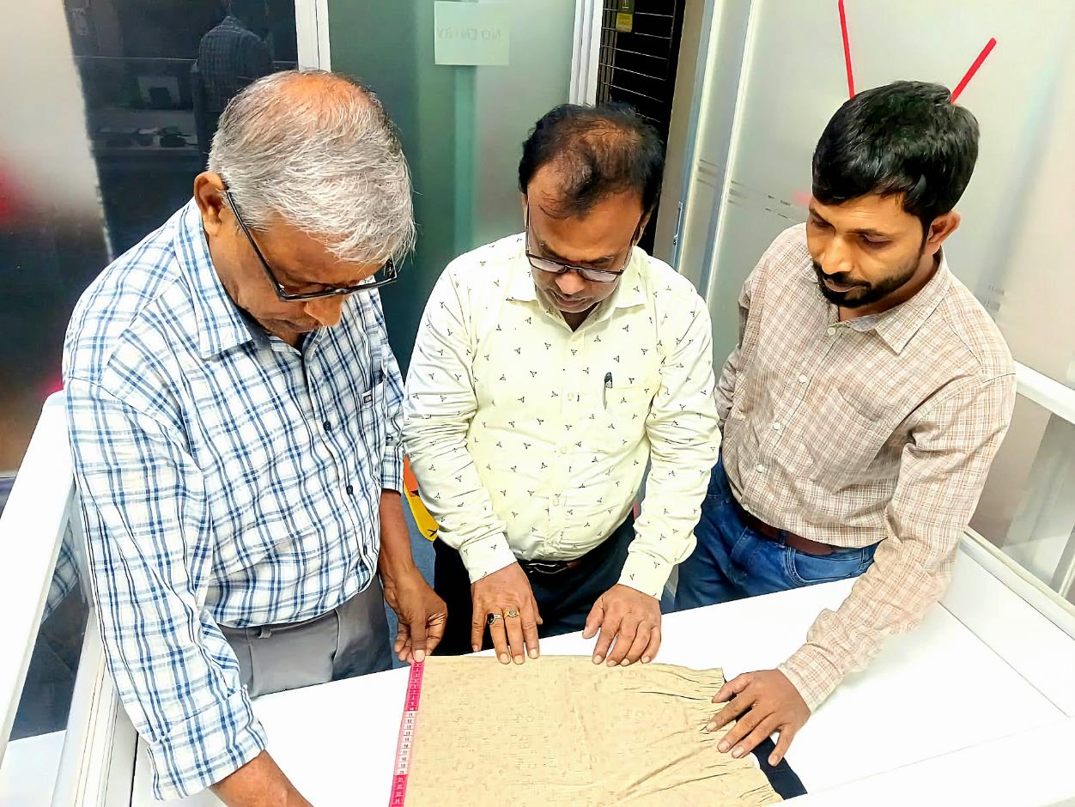


Brandview Sourcing Ltd.
About Us
Brandview Sourcing Limited is a well-established and reputable Garments buying house located in Dhaka, Bangladesh. Our experienced and dedicated sales, procurement, and quality control team offers comprehensive services, ensuring the supply of high-quality garments at competitive prices.
Our management team at Brandview Sourcing Limited is known for its strong integrity, accountability, and extensive professional experience in the local and global trade. With a solid reputation, we are committed to delivering exceptional service and exceeding client expectations.

Slide 3
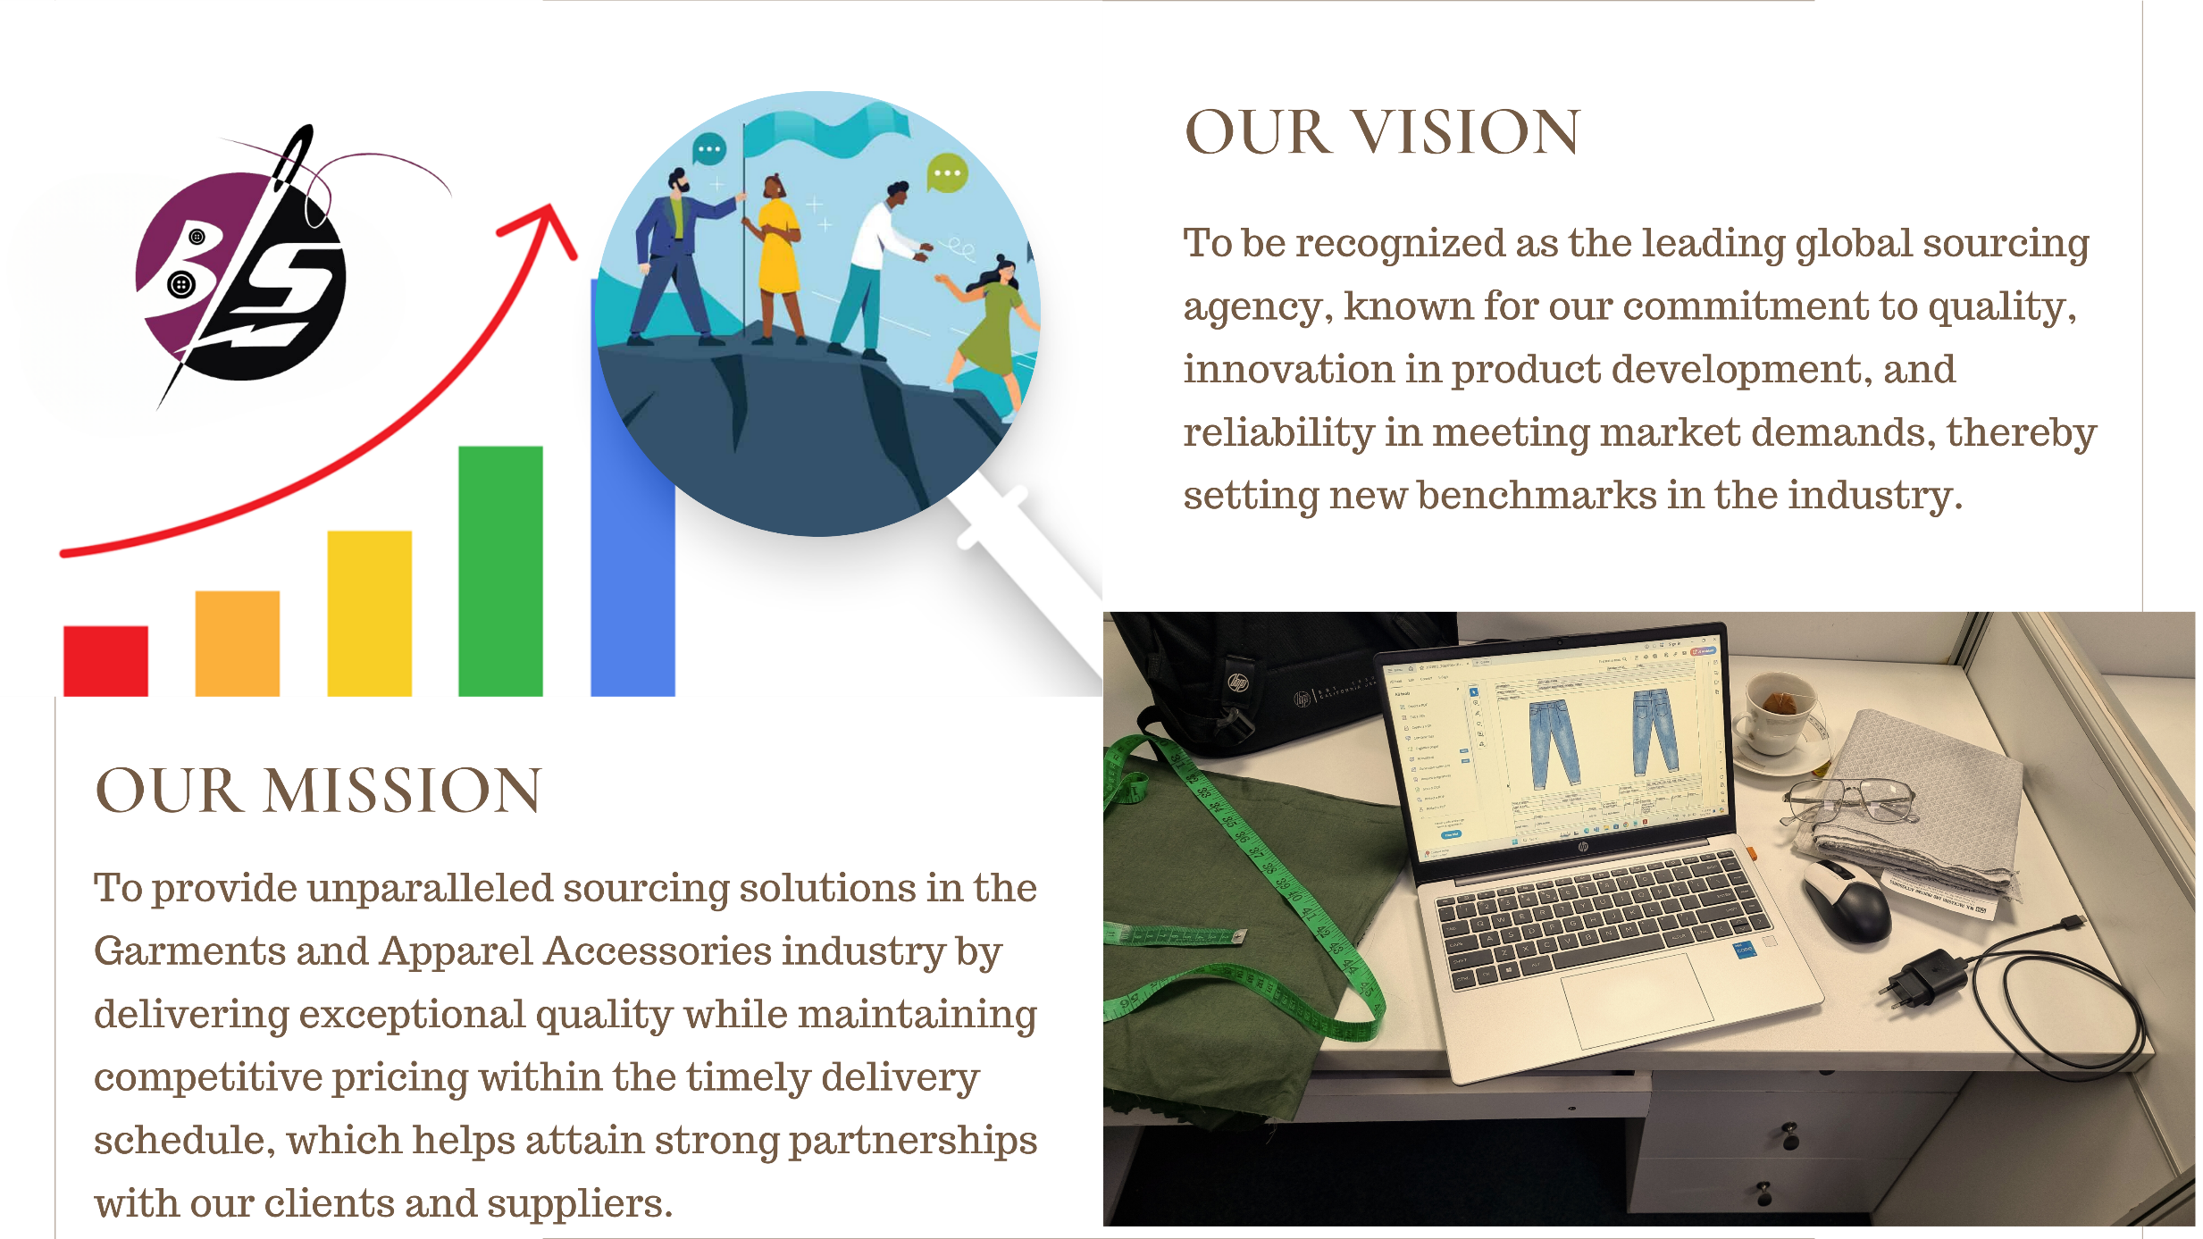
Brandview Sourcing Ltd.

Slide 4



Our Banking Partner
Brandview Sourcing Ltd.
Name of Company | Brandview Sourcing Ltd.
Year of Establishment | : 2024
Name of Business | : 100% Export oriented garments buying & selling.
Corporate Office Address | : Plot # 5/7, Road # 29/K, Rupnagar C/A, Mirpur, Dhaka-1216, Bangladesh
B.G.M.E.A Registration Number | : A.M-1282
Email | nannu@brandviewsourcing.com
Contact/Mobile | +880-1911345517
One of the leading bank in Bangladesh with countless number of awards
Mirpur Branch 1 NO DARUSSALAM ROAD MIRPUR-1, DHAKA-1216, BANGLADESH. www.citybankplc.com

Slide 5



Brandview Sourcing Ltd.
The Usual Problem
67%
3 out of 5
People look for basic
and flexible daily wearable
Need for affordable daily wearable

Slide 6






Brandview Sourcing Ltd.
Why choose US
Innovation and Product Development
Competitive Pricing
Quality Assurance
Expertise and Experience
Reliability and Timely Delivery
Strong Supplier Relationships

Slide 7

Brandview Sourcing Ltd.
Value Proposition
We provide custom tailored products according to the requirements
  Right Fabric Vendor
  Sample Studio
  Flexible design
  Quality Assured
  Perfect fit
  Sustainable
FEATURES
Custom and personalized
BENEFITS

Slide 8
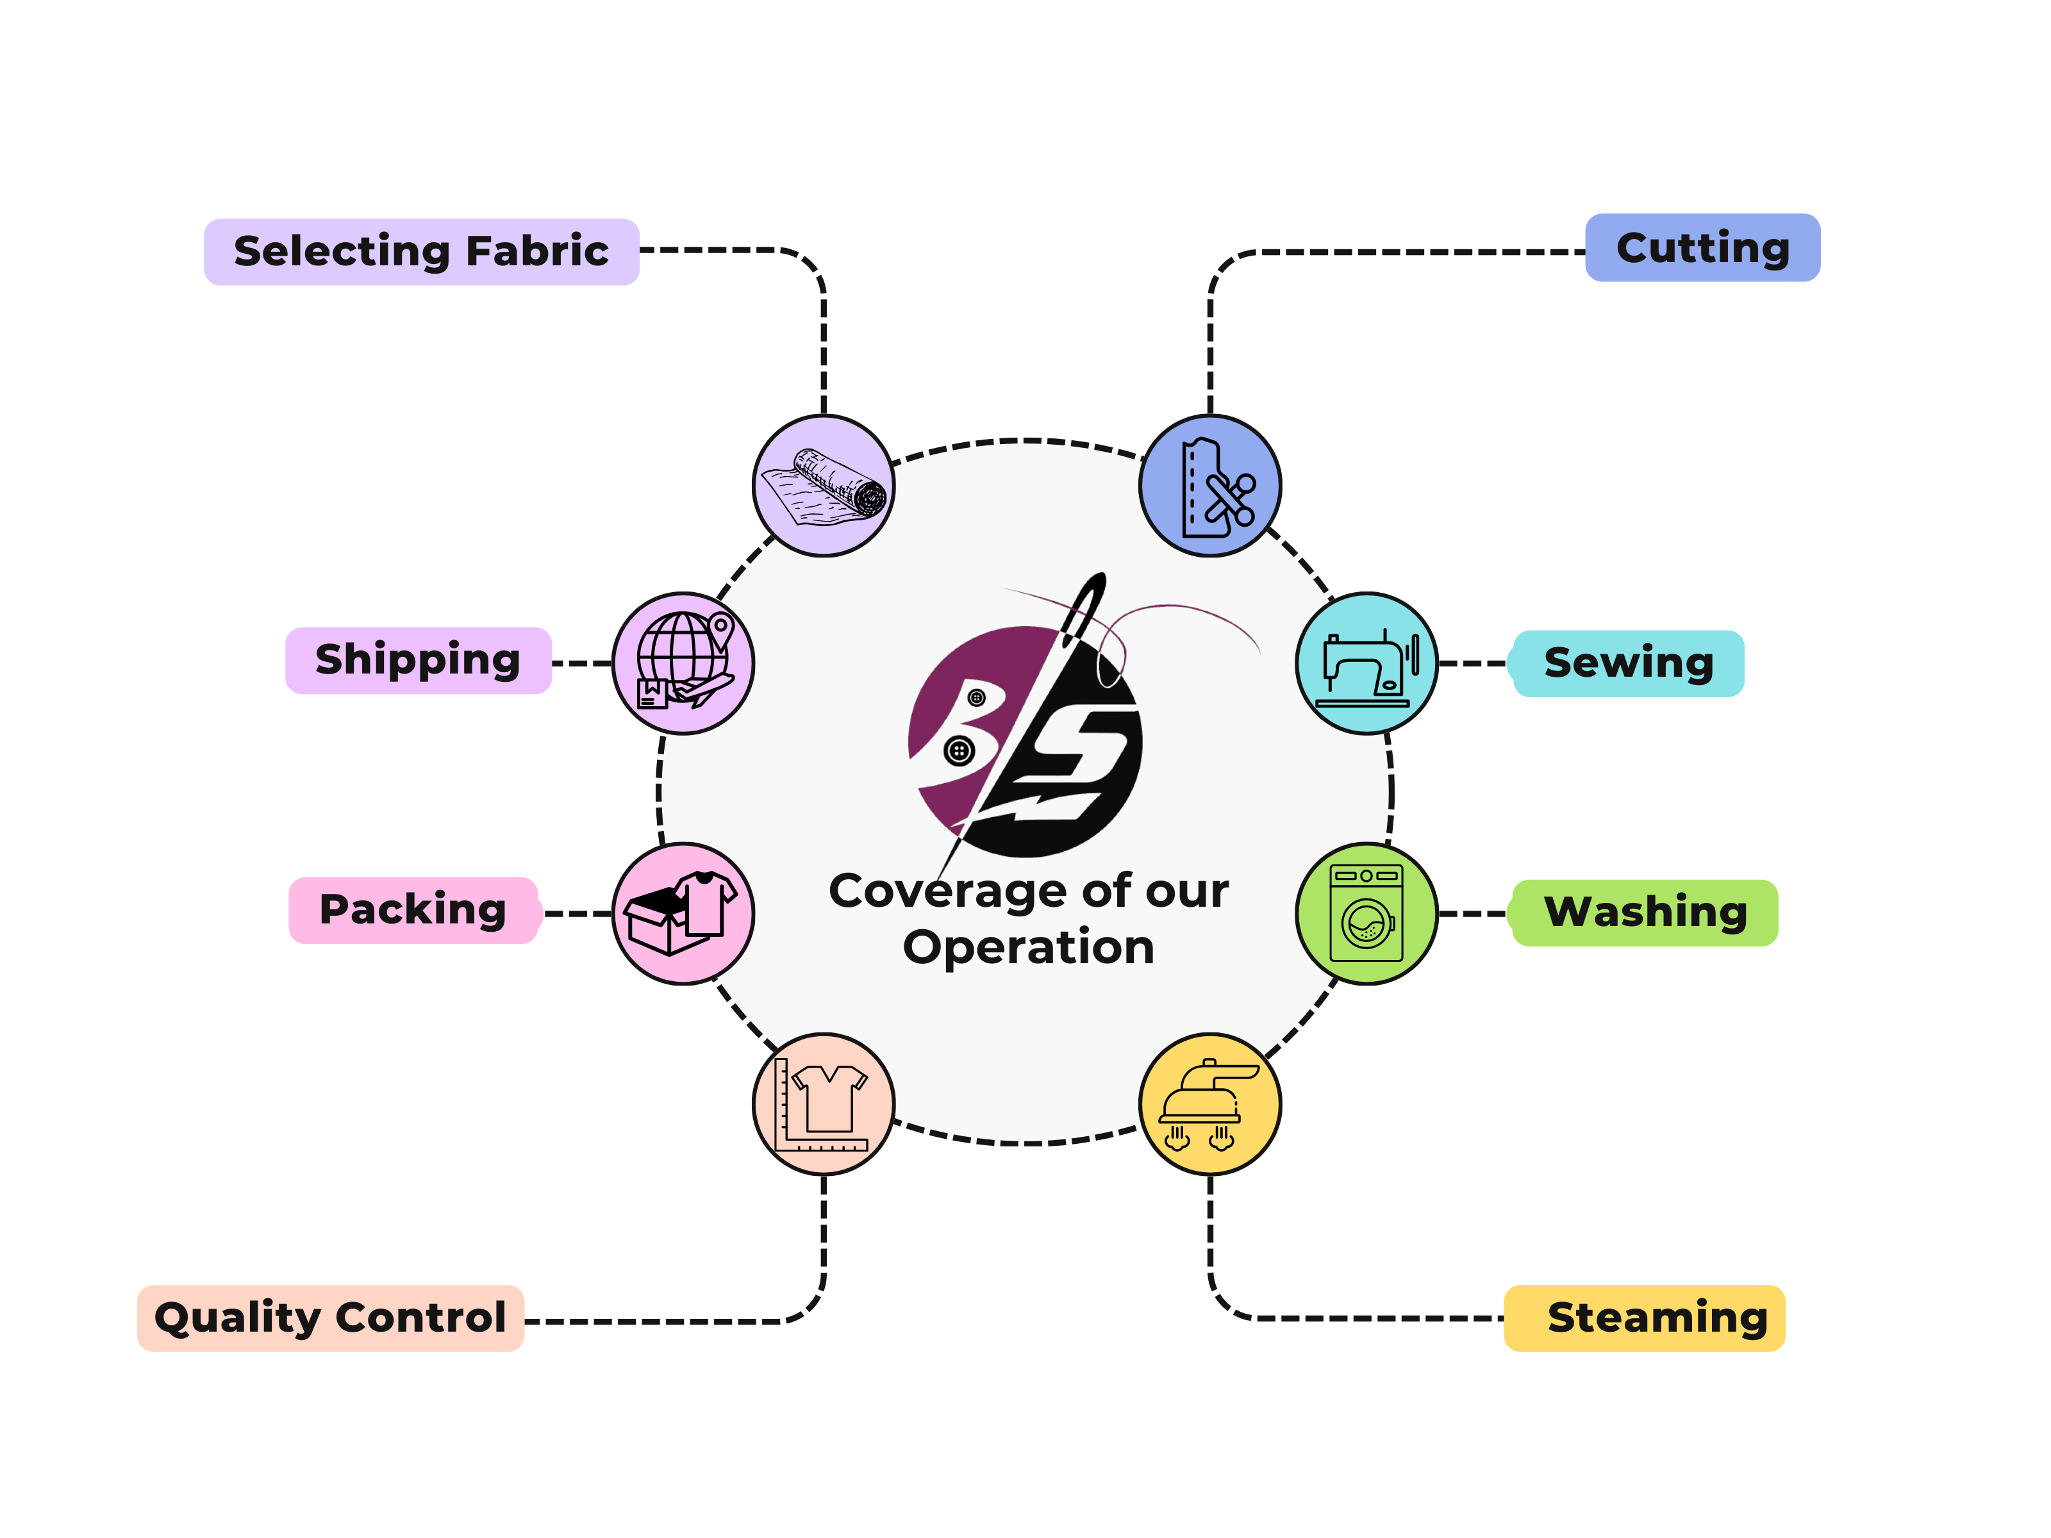
Brandview Sourcing Ltd.

Slide 9
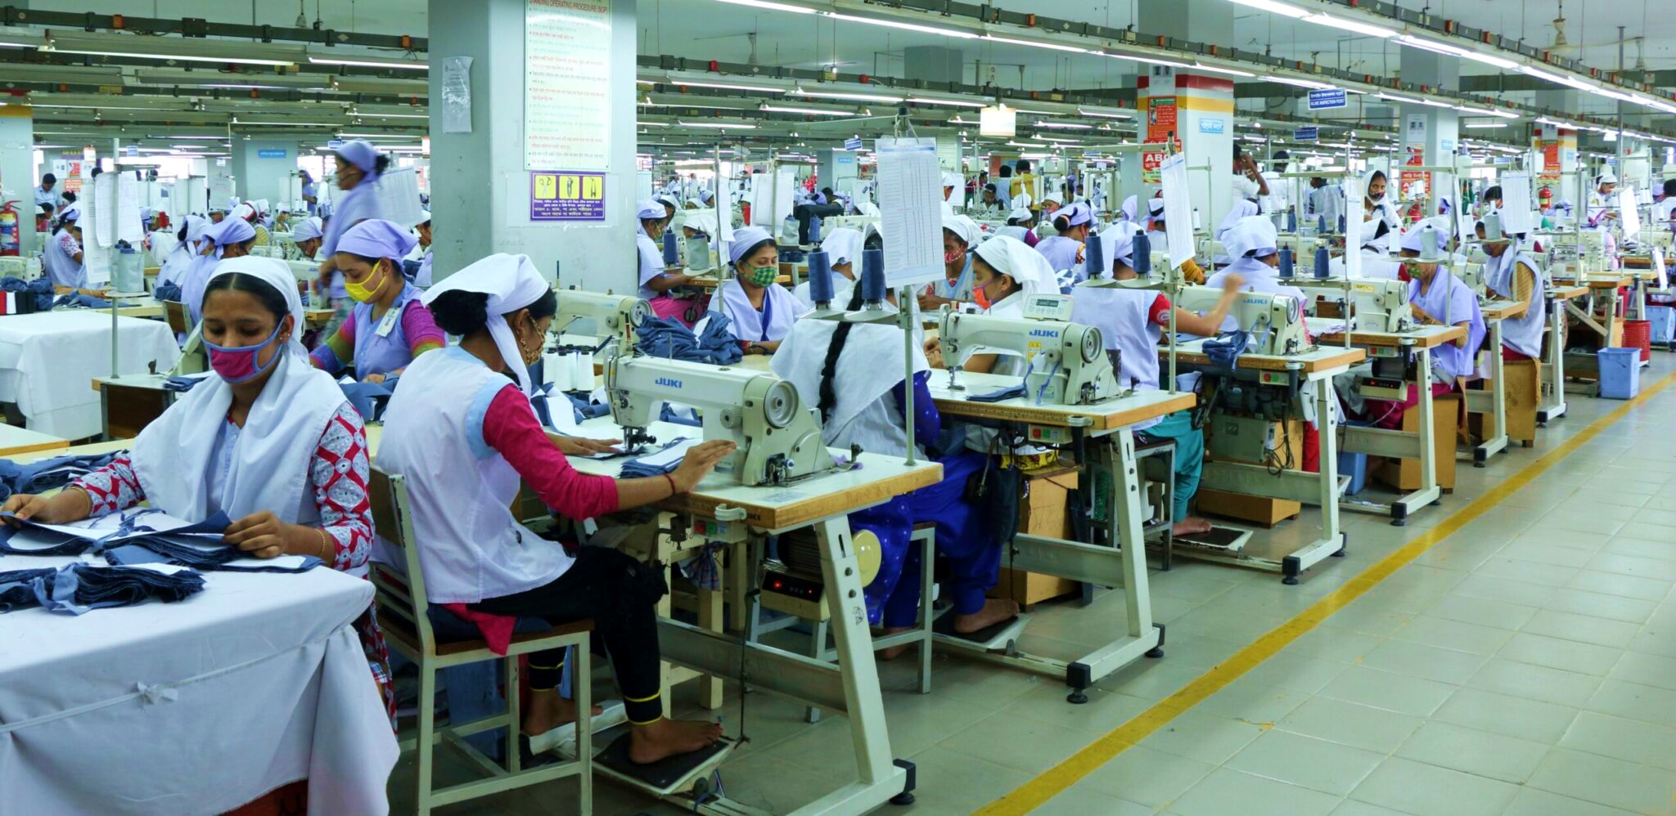
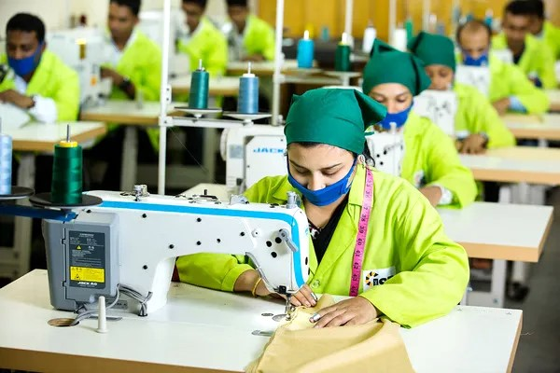
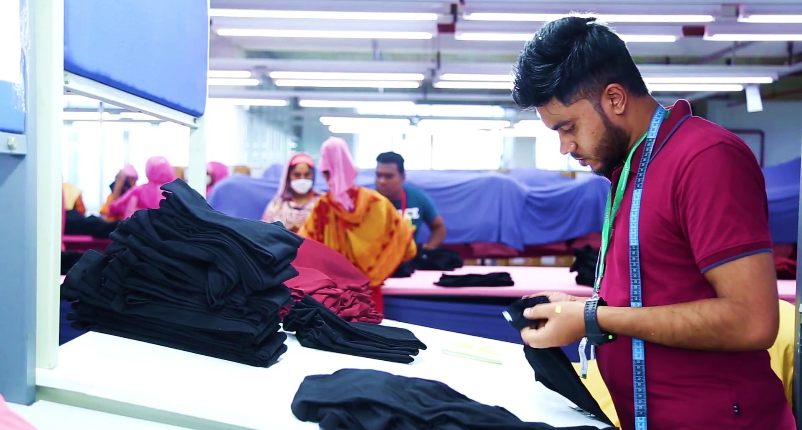
Brandview Sourcing Ltd.
Our Commitment in Action.
We uphold our commitment by carefully managing each step to ensure we just not meet your expectations rather exceed them.

Slide 10
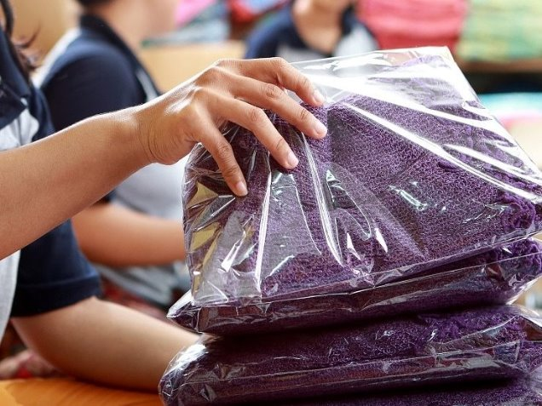
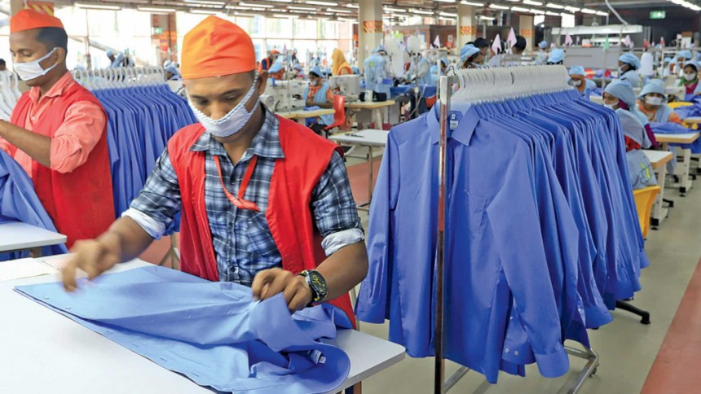

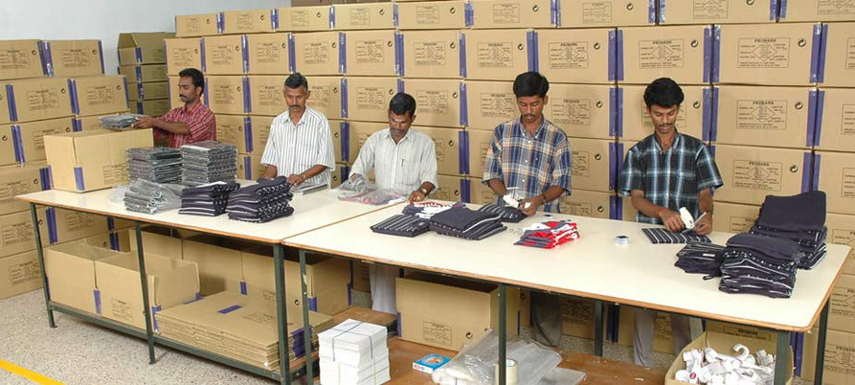

Brandview Sourcing Ltd.
Excellence is not a skill, it's an attitude.
Excellence isn’t just about having the right skills; it’s about cultivating the right mindset. It’s an attitude of unwavering commitment to doing your best, continuously improving, and embracing challenges with a positive, proactive approach.

Slide 11
Brandview Sourcing Ltd.
Our Strength Analysis
Extensive Supplier Network
Market Trend Analysis
Broad connections with global suppliers ensure top-quality products at competitive prices.
We scrutinize market trends of fabric, color and style by attending different fair and consult with trend analysis companies.
Comprehensive Logistics Support
Full-service logistics from transportation to distribution for smooth delivery.
Price Competitiveness
We Analyze the product and production efficiency to ensure competitive pricing.
Employee Engagement
Skilled professionals with deep industry knowledge to meet your specific needs.

Slide 12
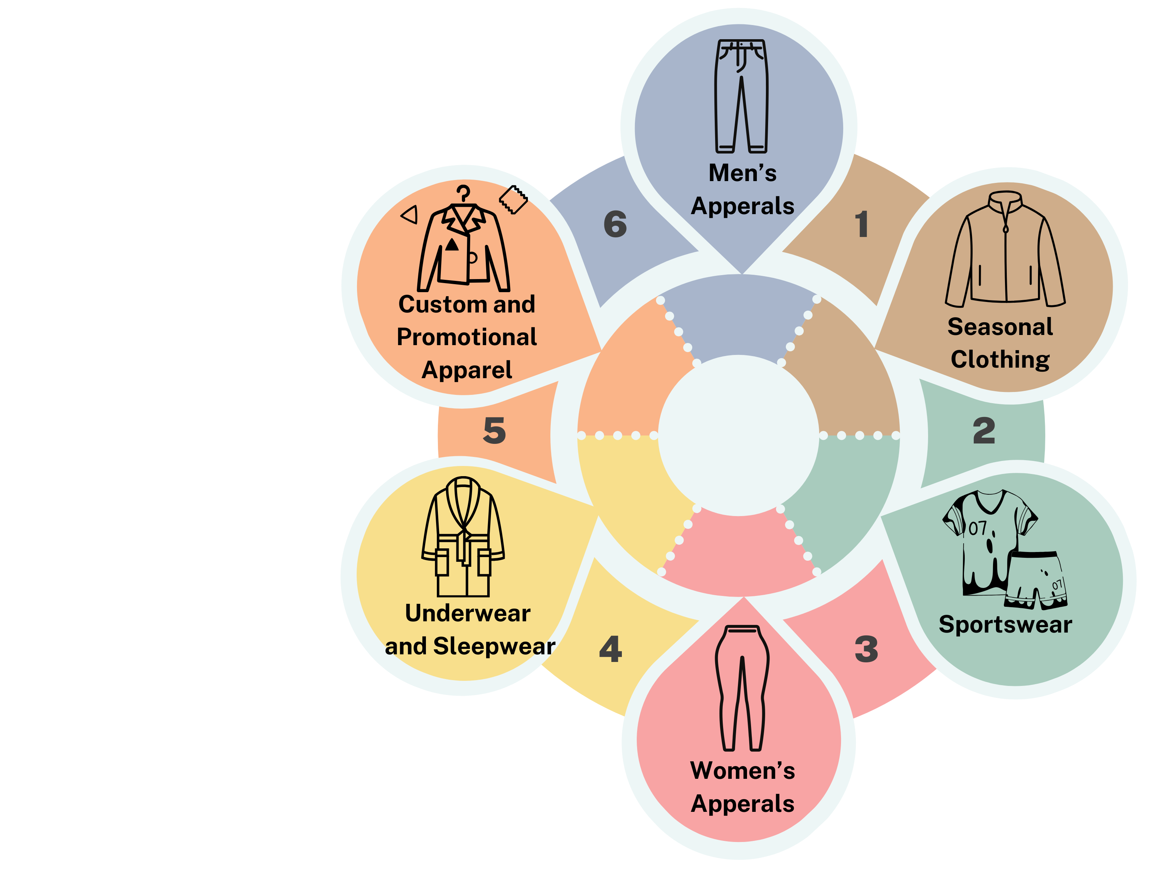
Brandview Sourcing Ltd.
Our Demographic Product Portfolio
Here’s an overview of the diverse product categories we handle, tailored to meet the needs of different demographic groups.

Slide 13
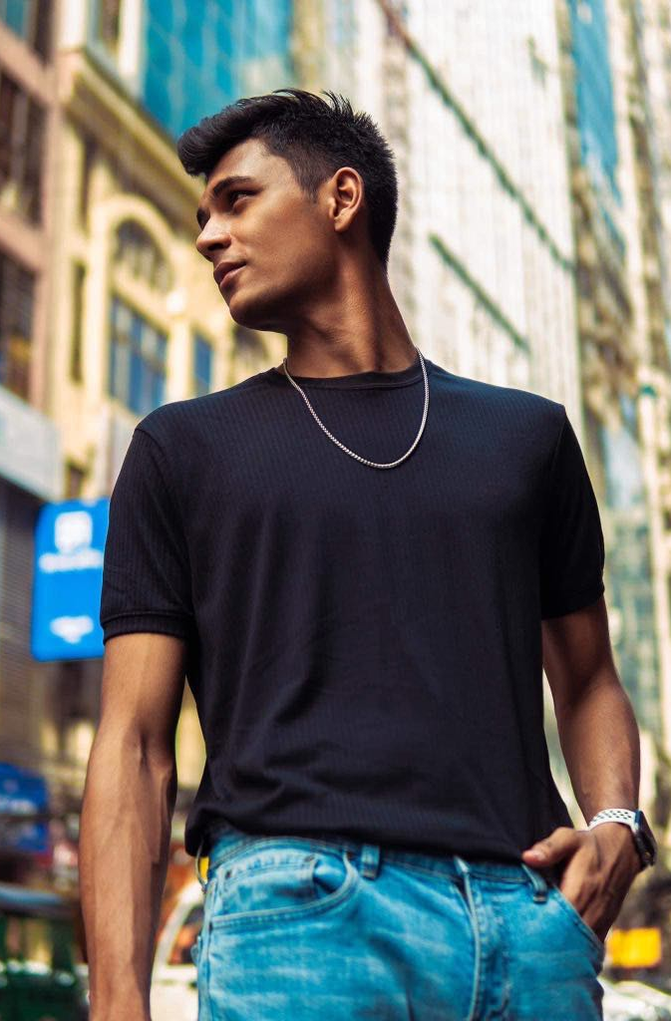
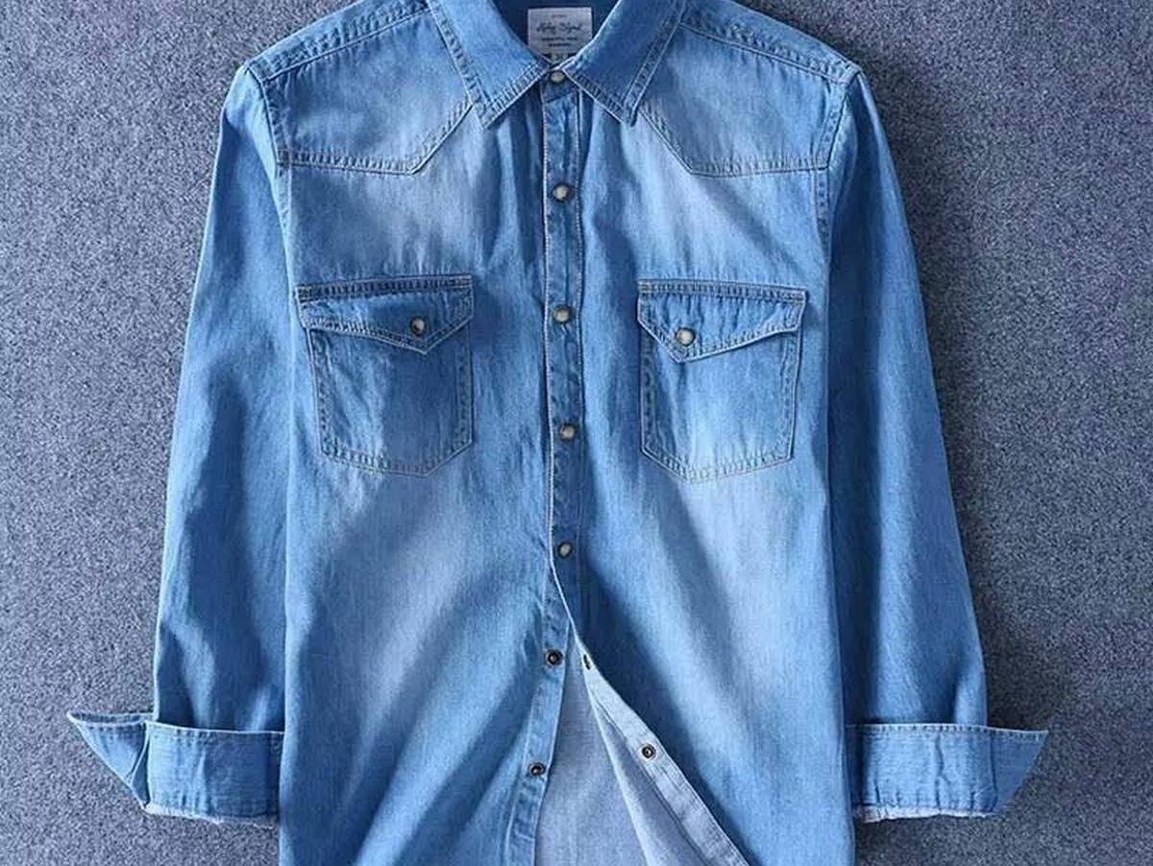
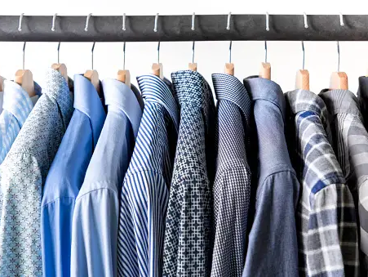
Brandview Sourcing Ltd.
Men’s Collection
Elevate Your Style with Our Men’s Collection
Discover our curated range of men’s apparel designed for every occasion. From timeless classics to contemporary trends, our collection features high-quality fabrics and impeccable craftsmanship.

Slide 14
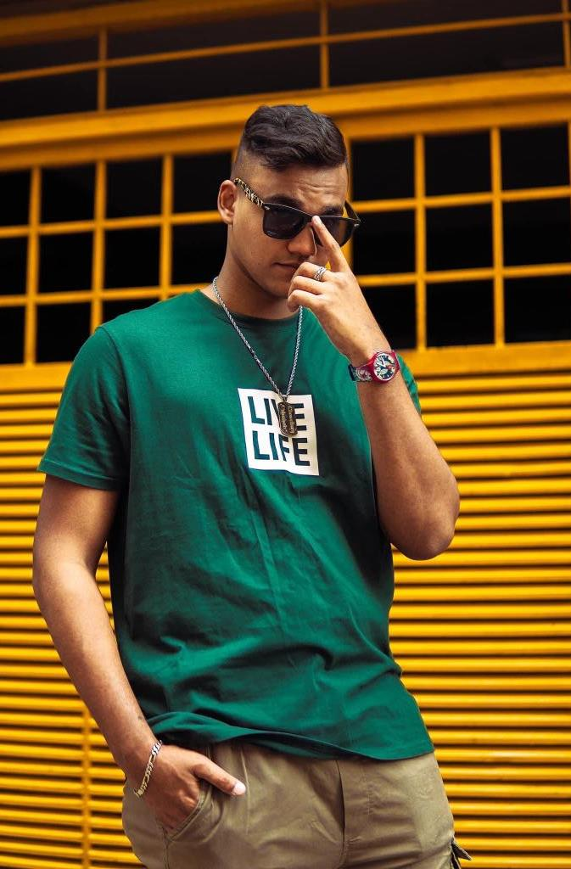
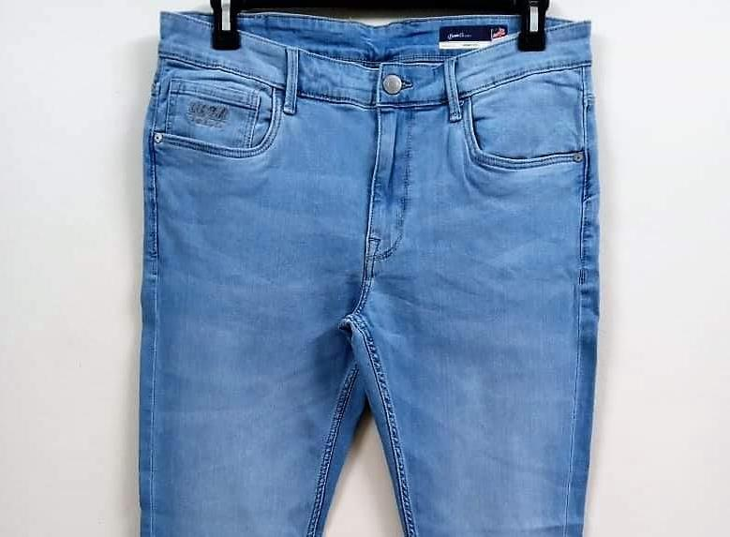
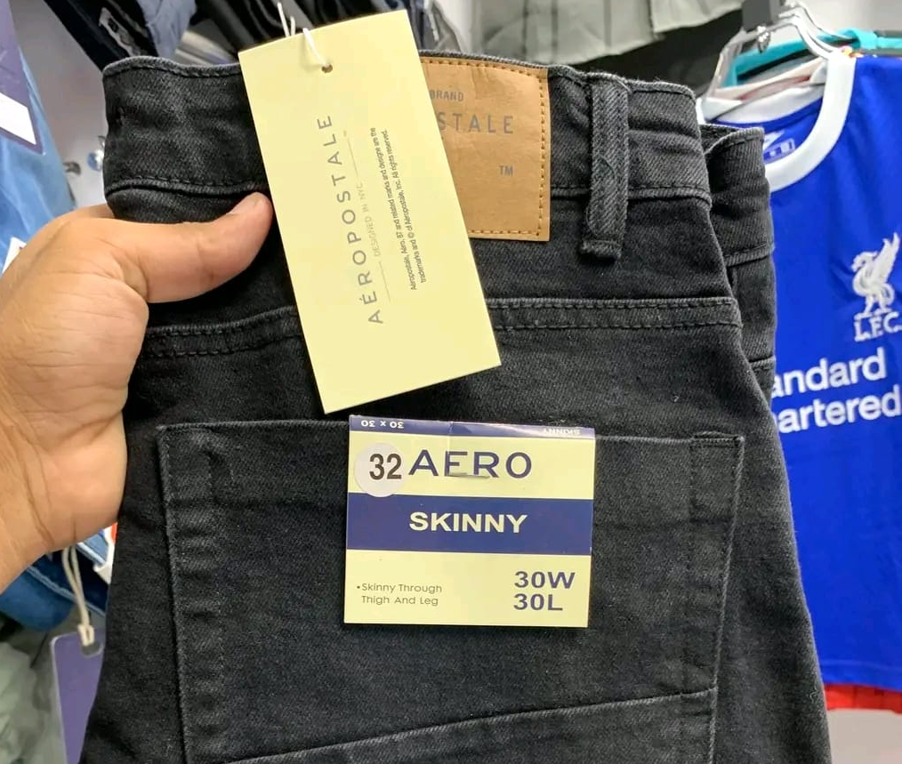
Brandview Sourcing Ltd.
Men’s Collection
Elevate Your Style with Our Men’s Collection
Whether you're dressing up for a business meeting or dressing down for a casual weekend, find the perfect pieces to express your style and confidence.

Slide 15
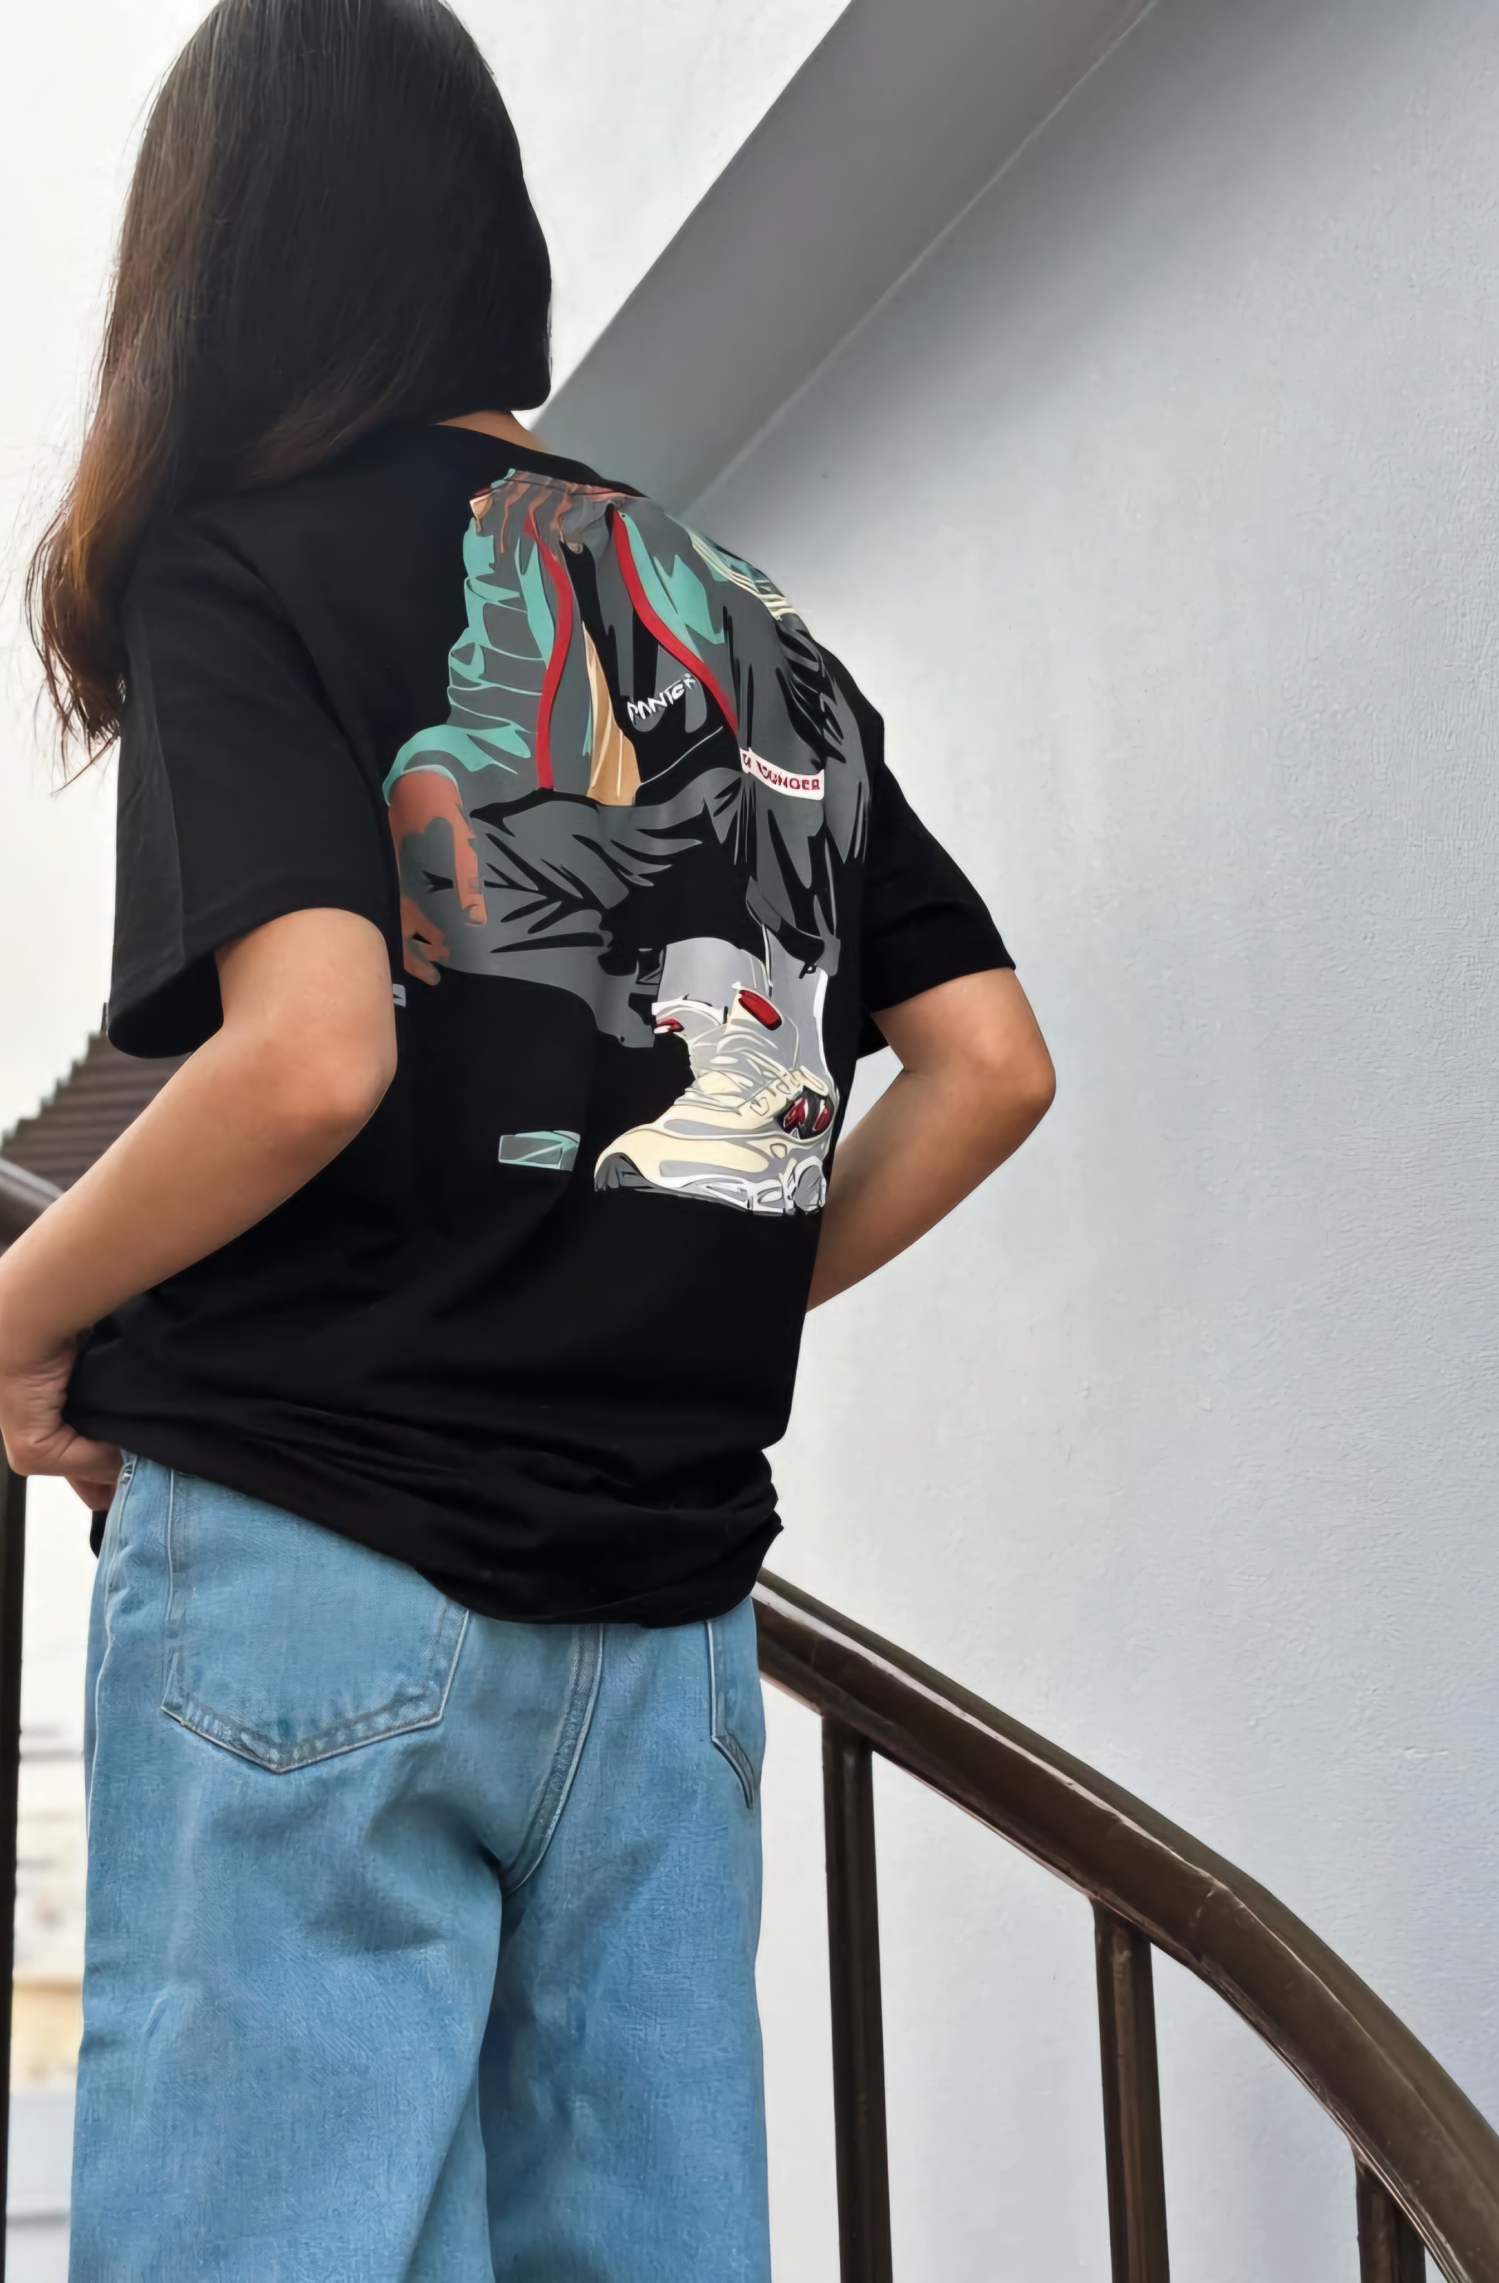
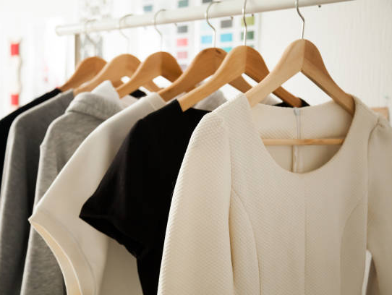
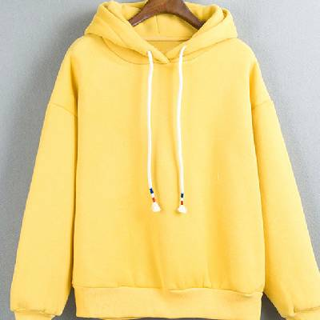
Brandview Sourcing Ltd.
Women’s Collection
Unleash Your Elegance with Our Women’s Collection
Embrace sophistication and grace with our exquisite women’s apparel. Our collection offers a blend of chic designs and versatile styles, crafted to enhance your wardrobe.

Slide 16
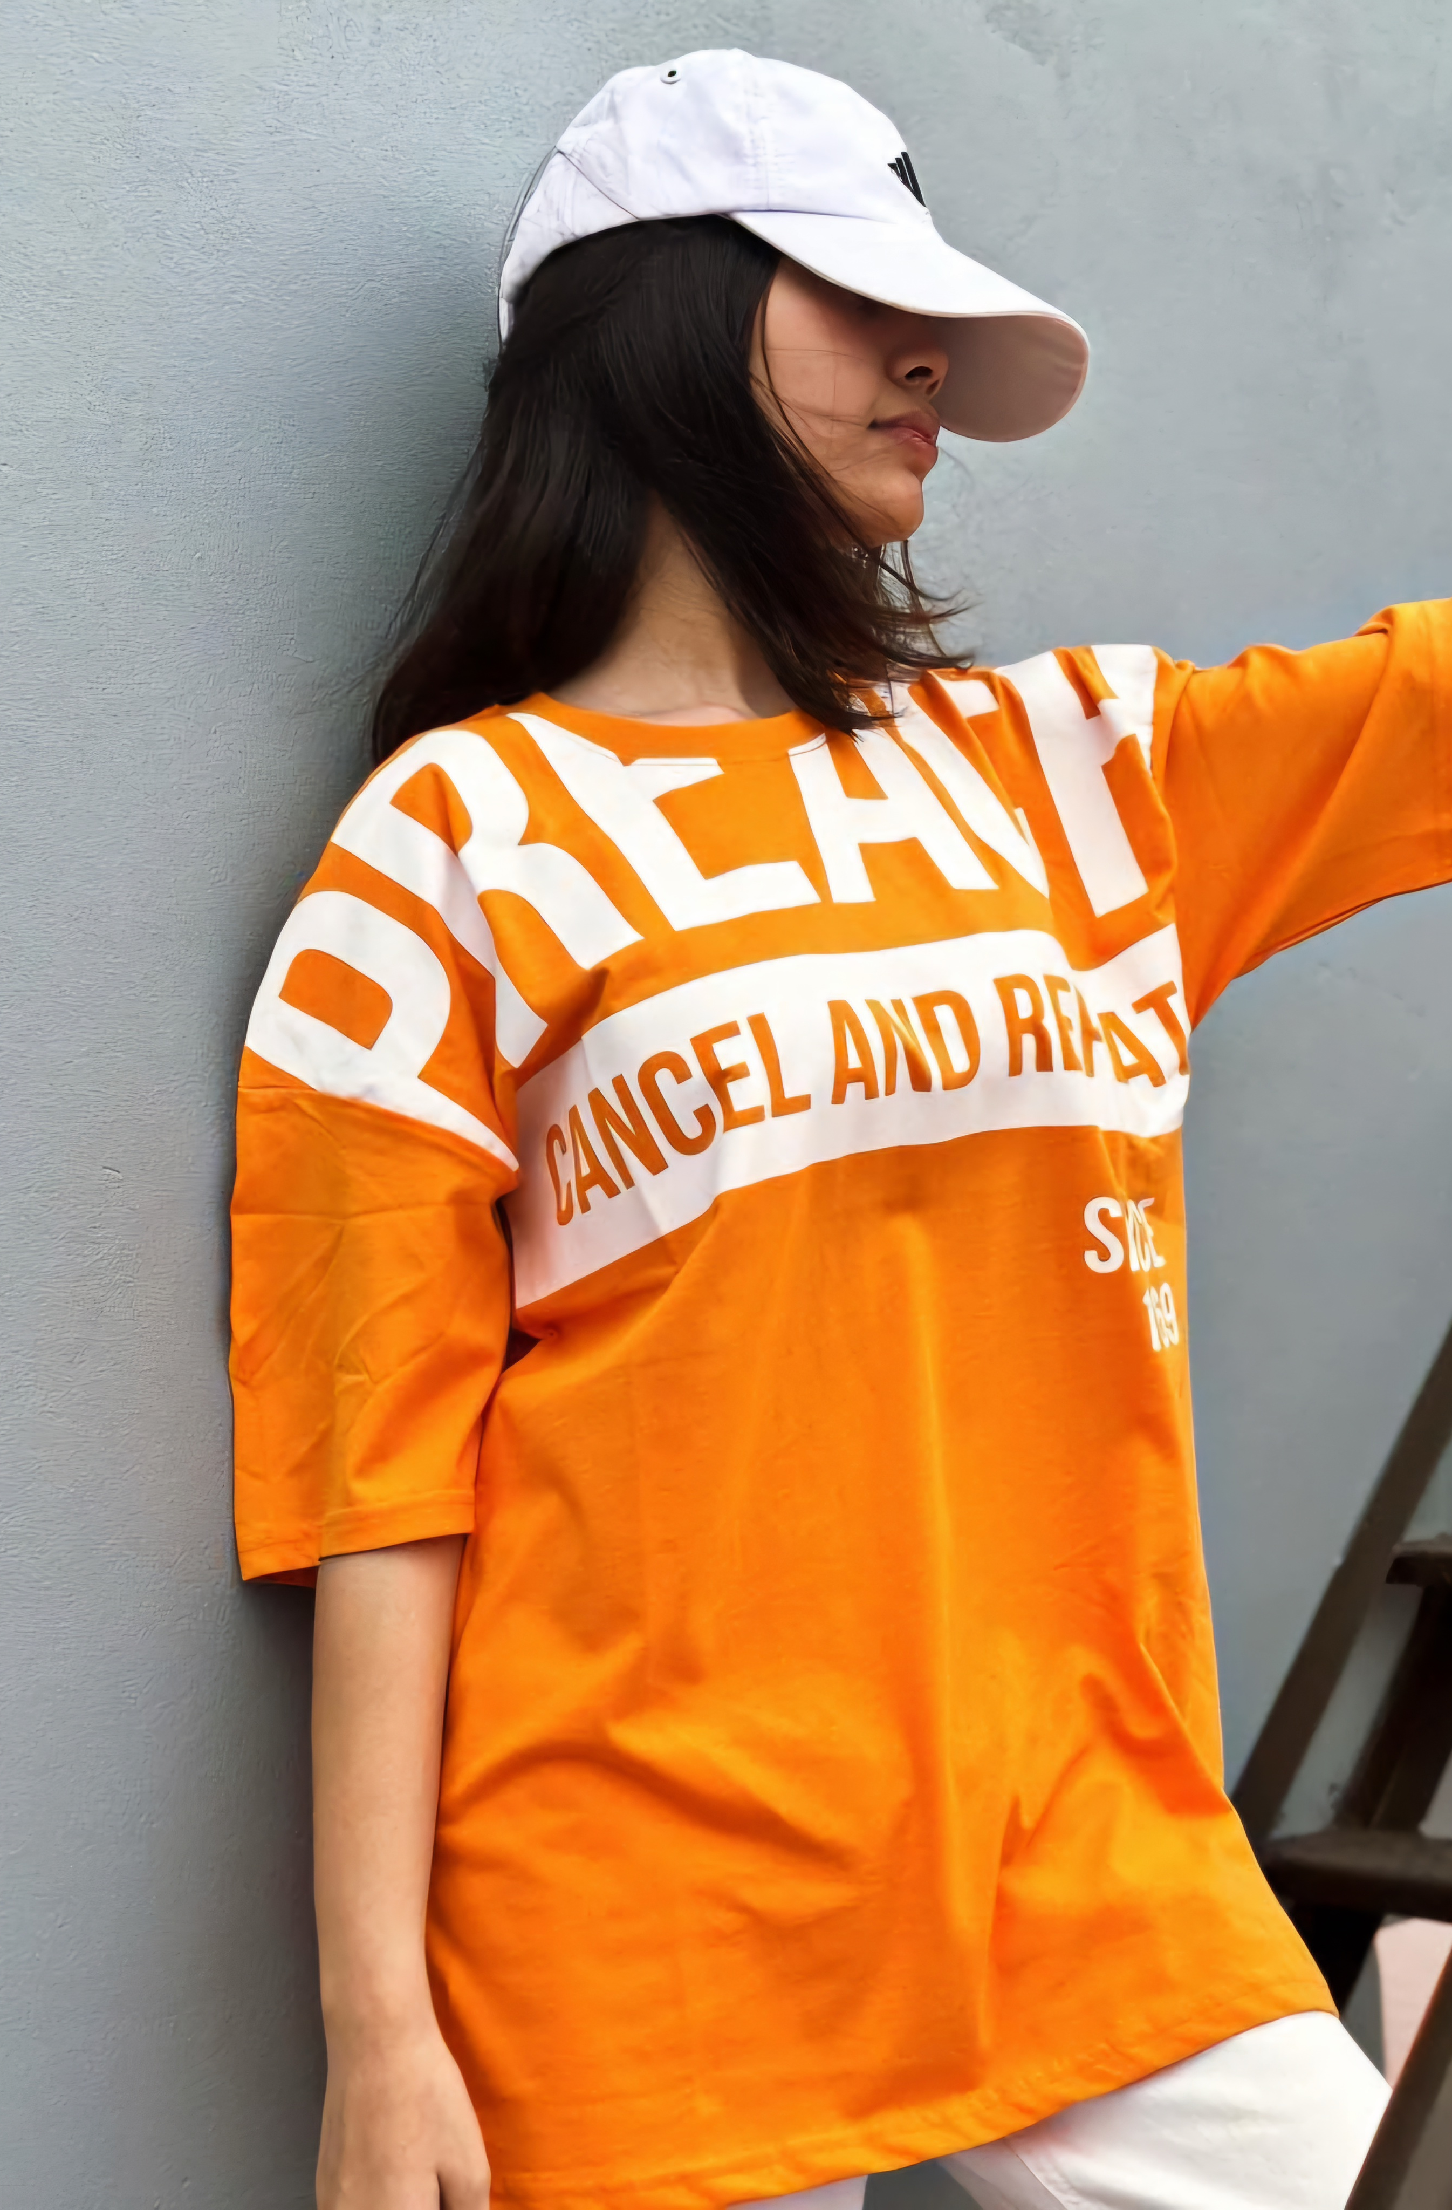
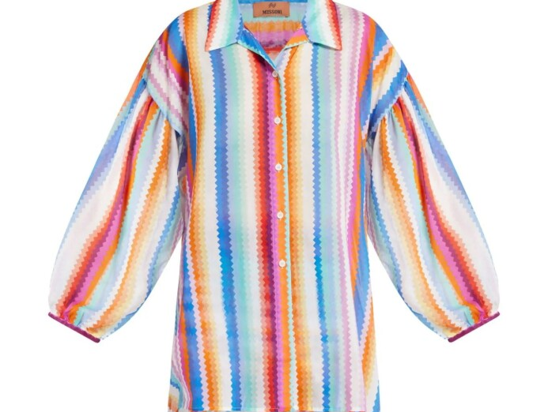
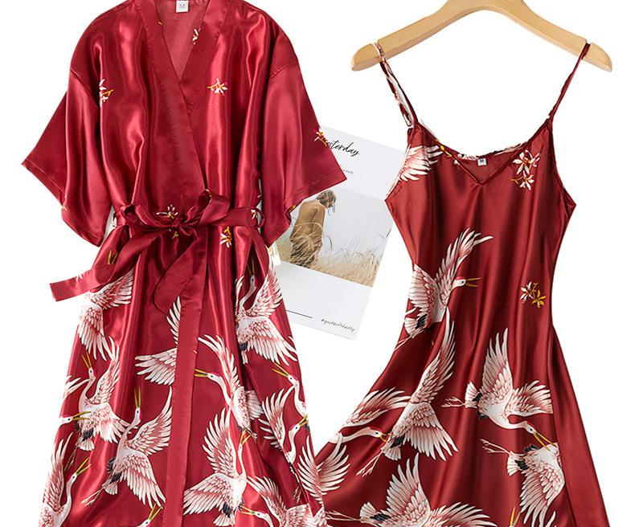
Brandview Sourcing Ltd.
Women’s Collection
Unleash Your Elegance with Our Women’s Collection
From elegant evening wear to comfortable everyday essentials, each piece is thoughtfully designed to make you look and feel fabulous, whatever the occasion.

Slide 17
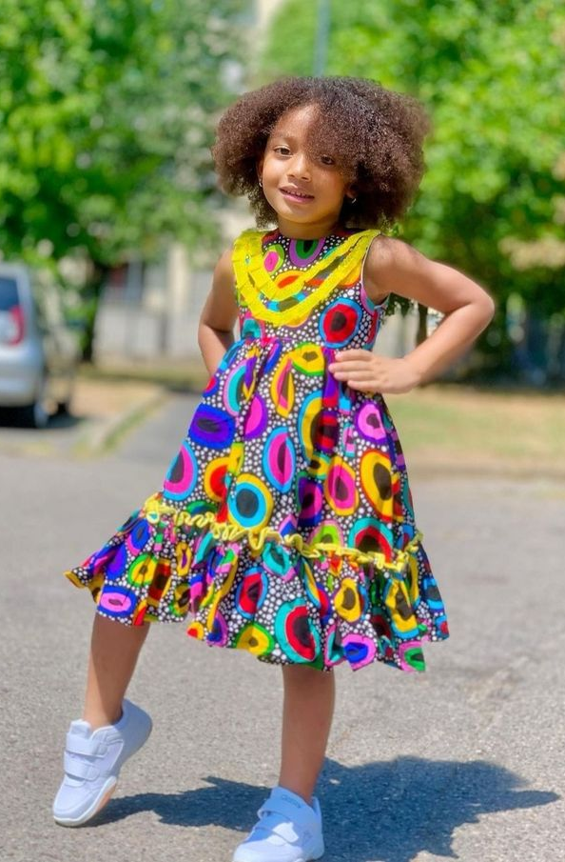
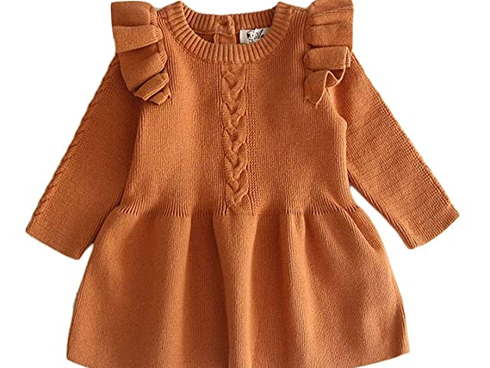
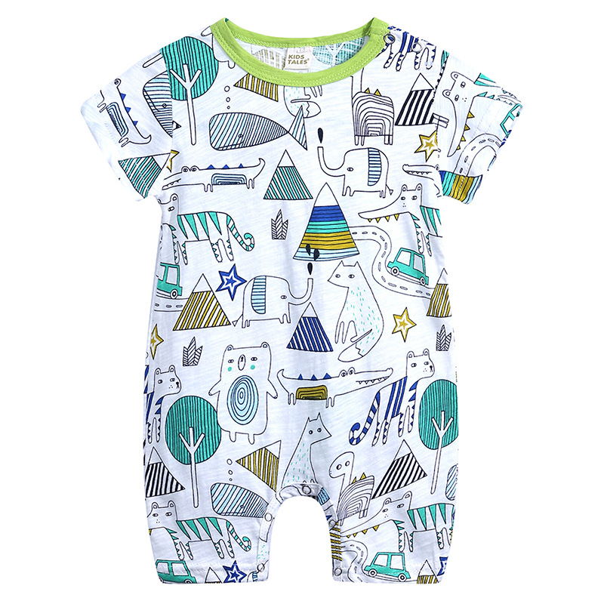
Brandview Sourcing Ltd.
Kids’ Collection
Playful and Practical: Explore Our Kids’ Collection
Delight in our vibrant and durable kids’ apparel designed to keep up with their active lifestyles.

Slide 18
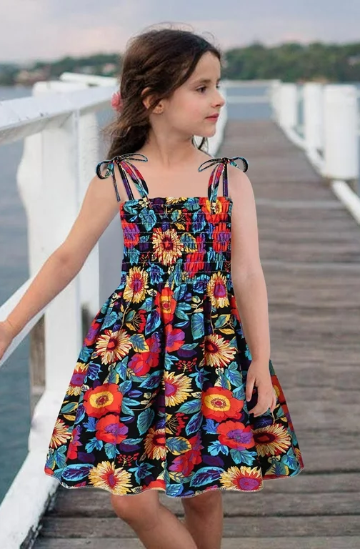
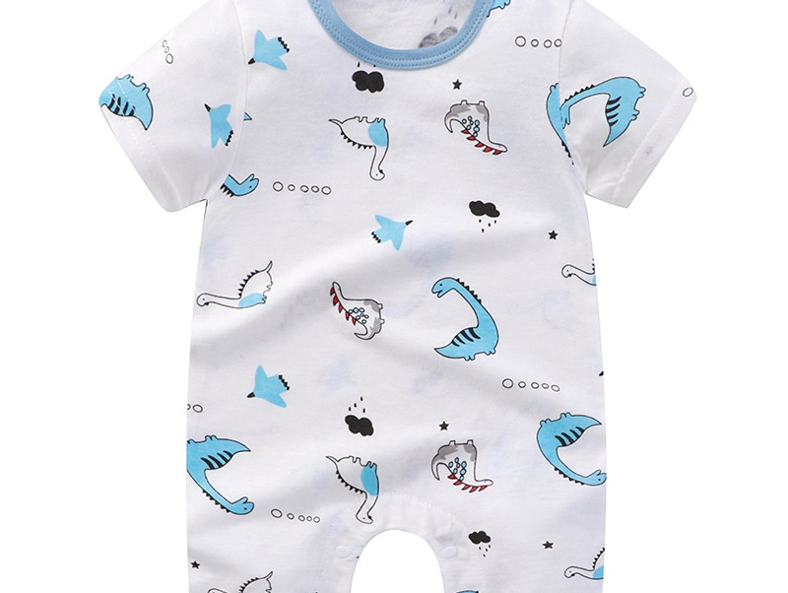
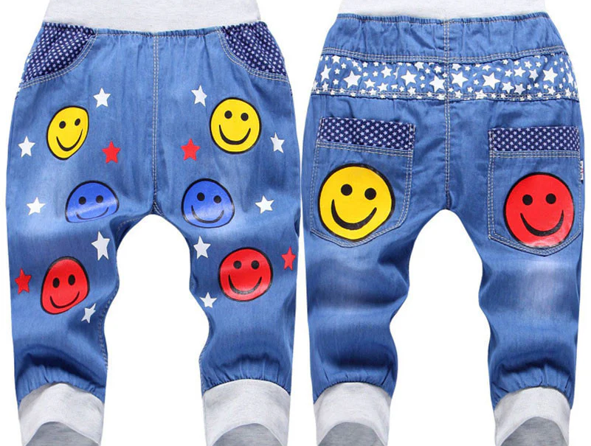
Brandview Sourcing Ltd.
Kids’ Collection
Playful and Practical: Explore Our Kids’ Collection
Our collection combines fun, fashion, and function, ensuring your little ones stay comfortable and stylish all day long. From playful prints to sturdy fabrics, our clothes are perfect for adventures big and small.

Slide 19
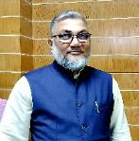

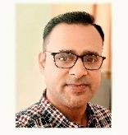
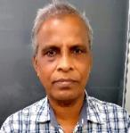
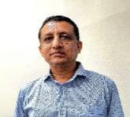
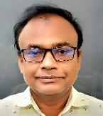
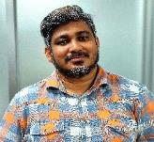
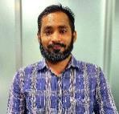
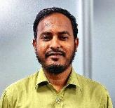
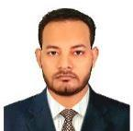
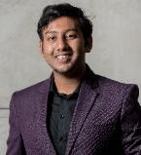
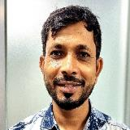
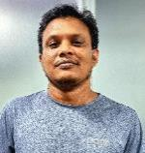
Brandview Sourcing Ltd.
Organogram
S.M ANISUR RAHMAN NANNU
Managing Director
ZAHANGIR ALAM RIPON
Chairman
FEBIN SASIN
Country Manager
Paritosh Debnath
Head of Merchandising
Sahinur Hossain
Head of Design & Development
Afzal Hossain
Head of Production
Rubel Talukder
Head of Quality Controller
Abdur Rouf
CAD Master
Hafiz Gomsta
Accountant
Ariful Islam
IT & System Administrator
Rafin Rayhan
Outbound Marketing
Asim Ballave
Admin Manager
M.A.M Murad
Assistant
Marketing Manager

Slide 20
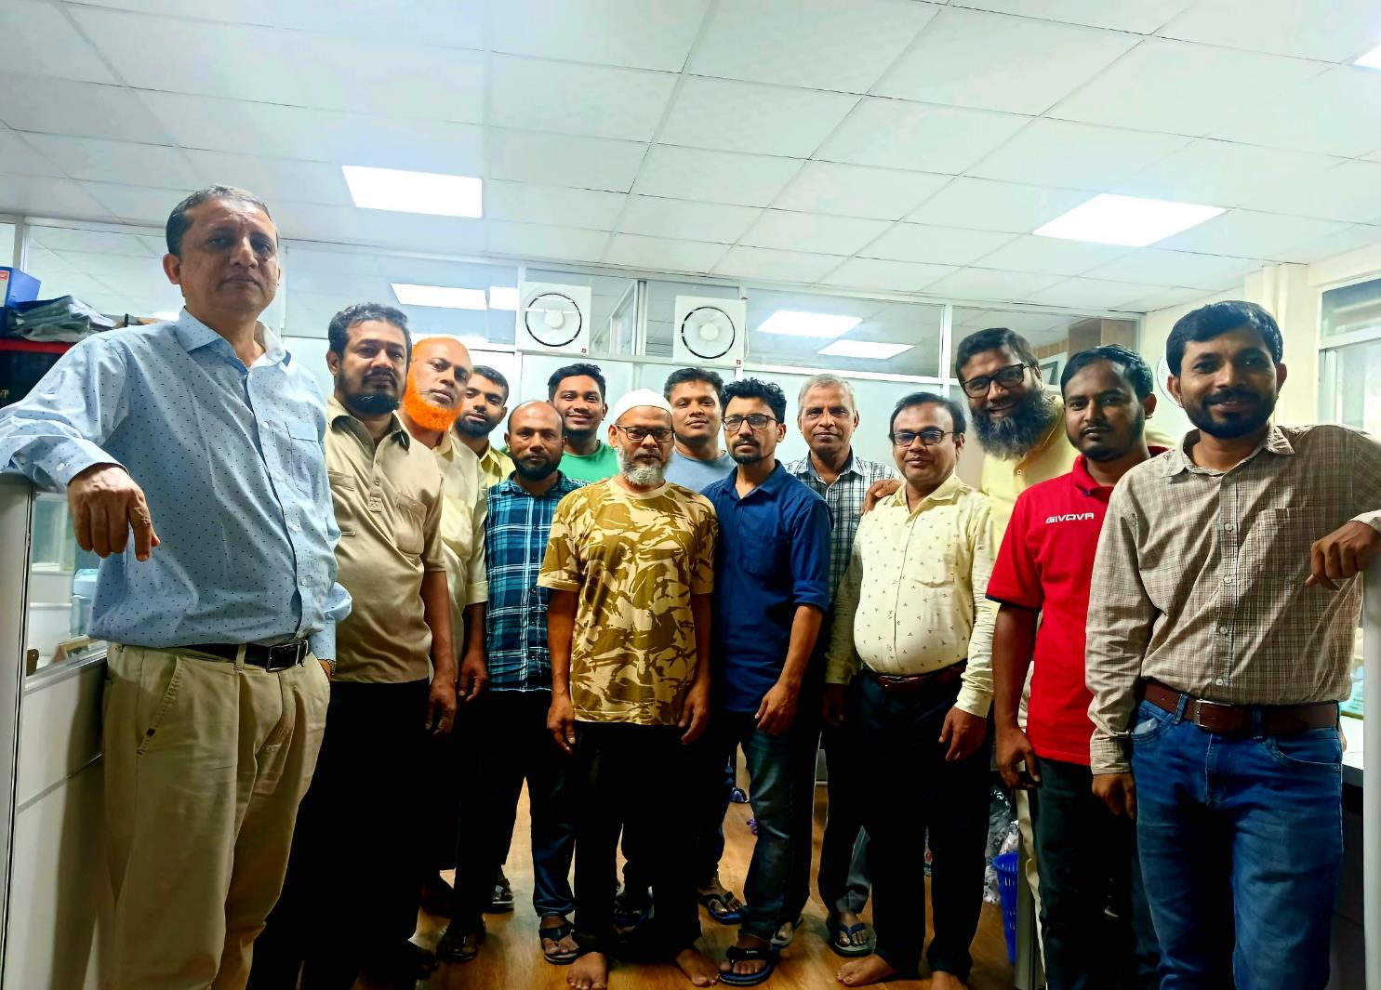
Brandview Sourcing Ltd.
Our Team At A Glance
At Brandview Sourcing our success is driven by our dedicated and experienced team. Each member brings unique skills and expertise to ensure we provide the best sourcing and buying solutions for our clients. Here’s a glimpse of the people behind our success.
Our team is committed to excellence and ready to assist you with all your buying needs. Together, we strive to deliver exceptional service and tailored solutions to meet your sourcing requirements.

Slide 21




Brandview Sourcing Ltd.
Thank you for staying with us
We’d Love to Hear from You!
Whether you have a question, need more information about our services, or just want to say hello, our team is here to help. Feel free to reach out to us through any of the following methods provided here.
Contact Us
Phone Number
+880-1819412170
+91-63662-54895
Email Address
ripon@brandviewsourcing.com
info@brandviewsourcing.com
Website
https://brandviewsourcing.com

