Slide 1


Brandview Sourcing Ltd.
Rhythm of Fashion & Aristocracy
Complete Apparel, Accessories, Printing & Packaging Solutions Under One Platform

Slide 2


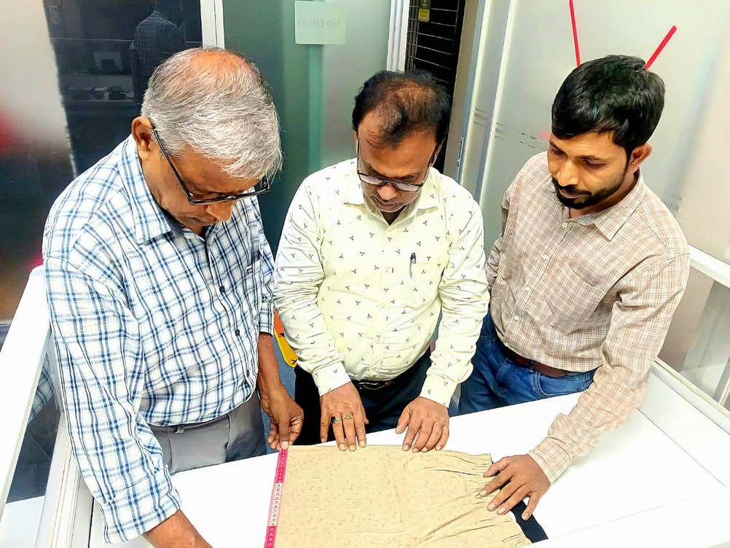


Brandview Sourcing Ltd.
About Us
Brandview Sourcing Ltd. is a Bangladesh-based, export-oriented garments buying house providing complete apparel sourcing, product development, production follow-up, quality assurance, accessories, printing, packaging, and shipment coordination services for international buyers.
Our experienced team manages every stage of the order process, from fabric and material sourcing to sampling, production monitoring, quality inspection, packing, and shipment follow-up. We are committed to transparency, competitive pricing, consistent quality, and timely delivery.
Notes:
2

Slide 3



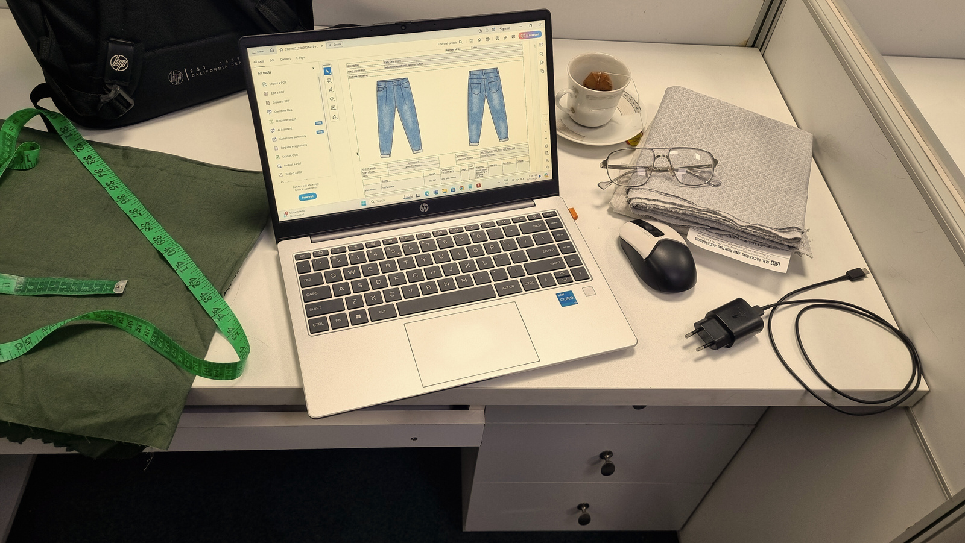
OUR VISION
To become a trusted global apparel sourcing partner from Bangladesh, recognized for quality, reliability, transparency, competitive pricing, and professional order management.
OUR MISSION
To provide international buyers with complete sourcing solutions through reliable supplier selection, product development support, strict quality monitoring, efficient production follow-up, and timely shipment coordination.

Slide 4

Brandview Sourcing Ltd.
Why International Buyers Choose Brandview Sourcing Ltd.
Brandview Sourcing Ltd. offers a complete sourcing solution for buyers seeking dependable apparel production support from Bangladesh. We combine market knowledge, supplier access, quality supervision, and export coordination to help our clients place orders with confidence.
Our key strengths include:
  Reliable supplier and factory network
  Competitive price negotiation
  Fabric, trims, and accessories sourcing
  Sample development and approval follow-up
  Production planning and order monitoring
  Inline and final quality inspection
  Packing and shipment coordination
  Transparent buyer communication
  Flexible support for small, medium, and bulk orders

Slide 5






Brandview Sourcing Ltd.
Why choose US
Innovation and Product Development
Competitive Pricing
Quality Assurance
Expertise and Experience
Reliable supplier and factory network
Strong Supplier Relationships

Slide 6



Brandview Sourcing Ltd.
Value Proposition
We provide custom-tailored sourcing solutions based on buyer requirements.
    Approved Fabric & Material Suppliers
    Sample Development Support
    Flexible Design Support
    Quality Assured
    Accurate Fit & Measurement
    Sustainable Sourcing Options
FEATURES
Custom and personalized
BENEFITS

Slide 7











Brandview Sourcing Ltd.
Fabric Selection
Accessories Sourcing
Shipping
Cutting
Packing
Coverage of our Operation
Sewing
Finishing & Steaming
Washing
Quality Control
Printing

Slide 8
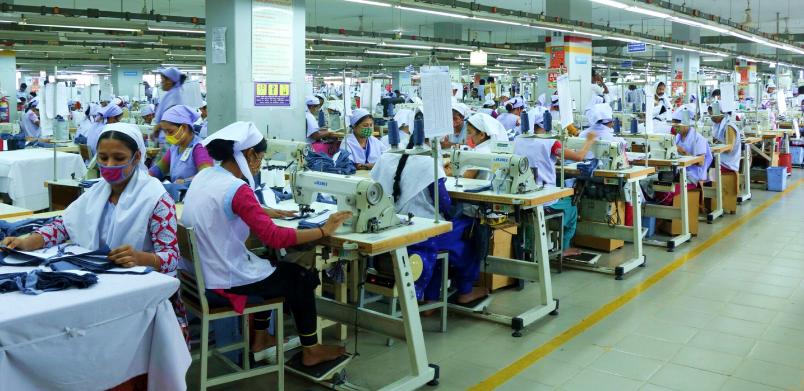
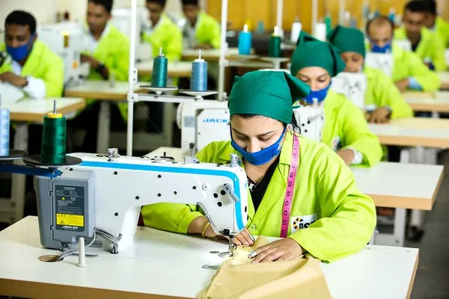
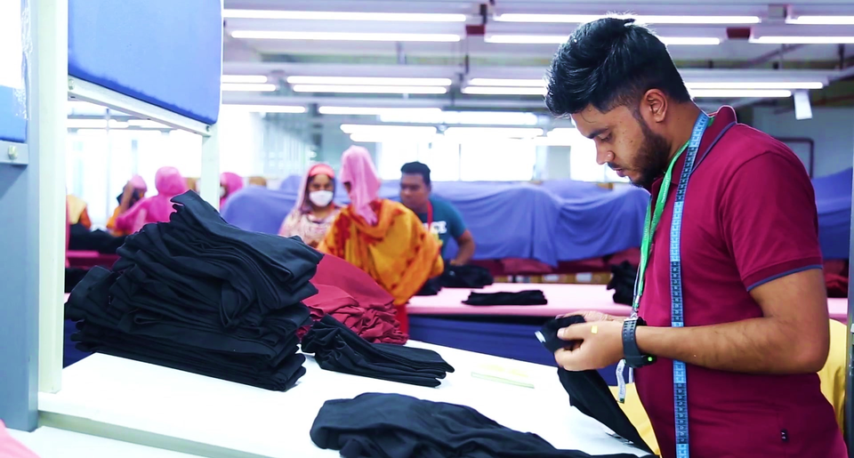
Brandview Sourcing Ltd.
Our Commitment in Action.
We uphold our commitment by carefully managing every stage of the order process. From supplier selection and product development to quality inspection and shipment coordination, our team works to meet buyer requirements and exceed expectations through reliable execution.

Slide 9
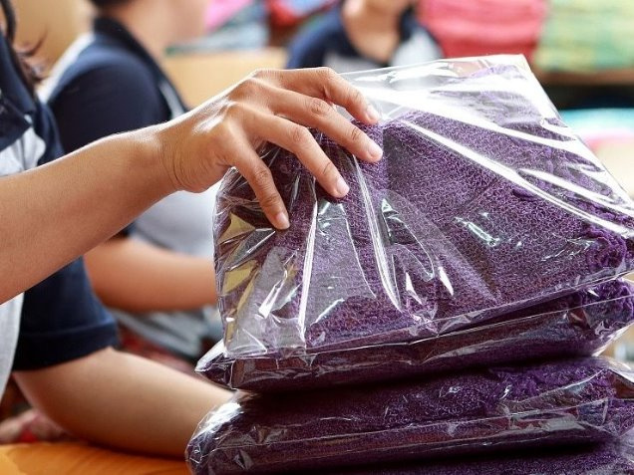
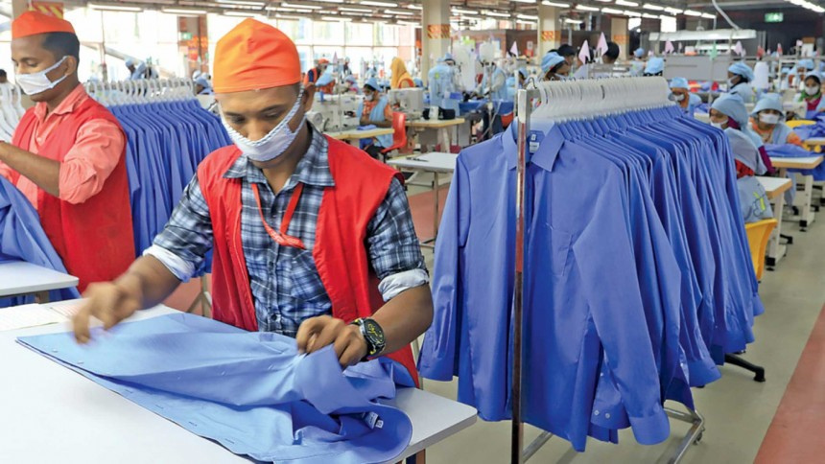

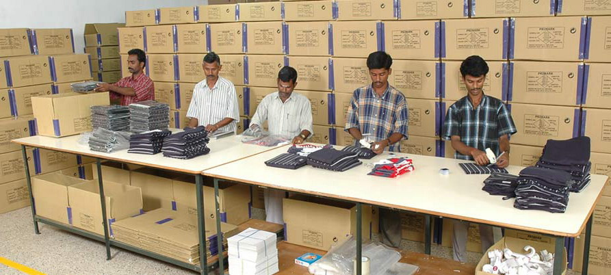

Brandview Sourcing Ltd.
Excellence Is Our Working Standard
Excellence is not only about skill; it is about discipline, responsibility, and continuous improvement. At Brandview Sourcing Ltd. we approach every order with attention to detail, proactive communication, and a commitment to delivering reliable results for our buyers.
Notes:
10

Slide 10
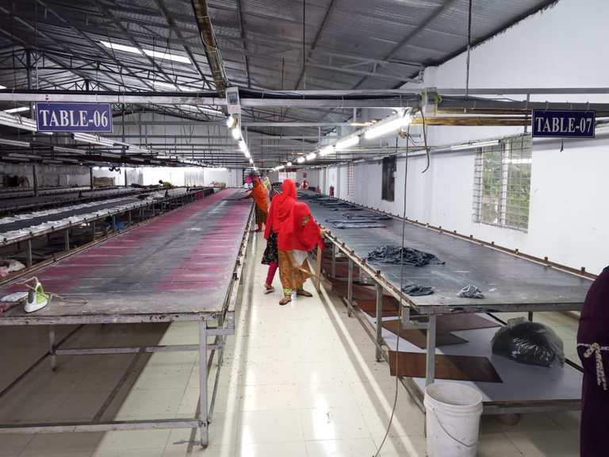
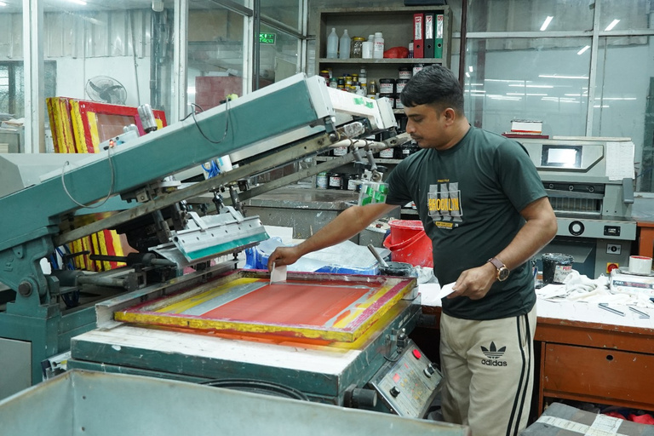
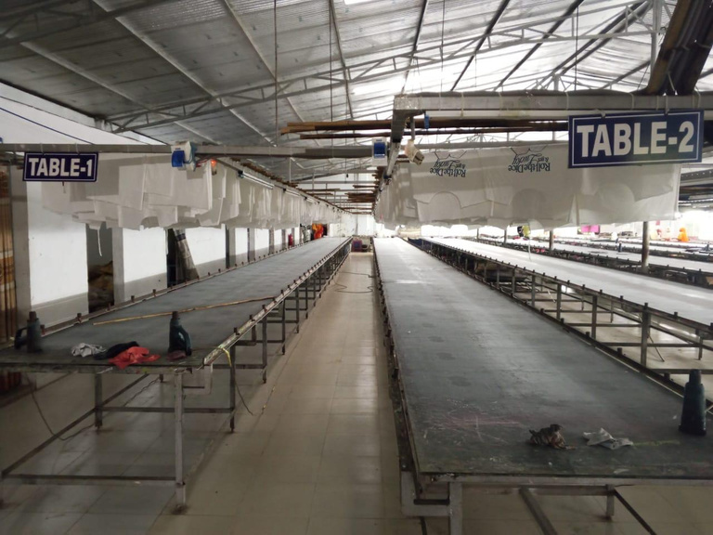
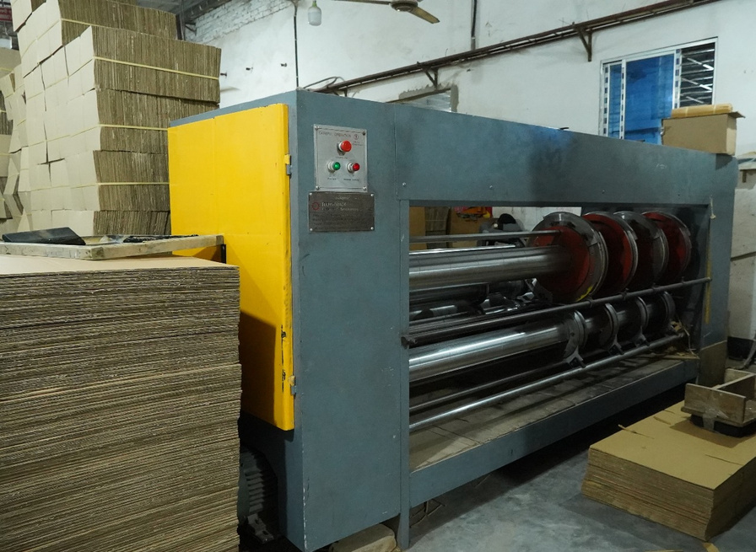
Brandview Sourcing Ltd.
Printing & Packaging Support
  Modern printing support for labels, tags, cartons, and packaging materials
  Paperboard and carton processing support for export packaging requirements
  Screen printing and branding support for customized apparel orders
Notes:
10

Slide 11
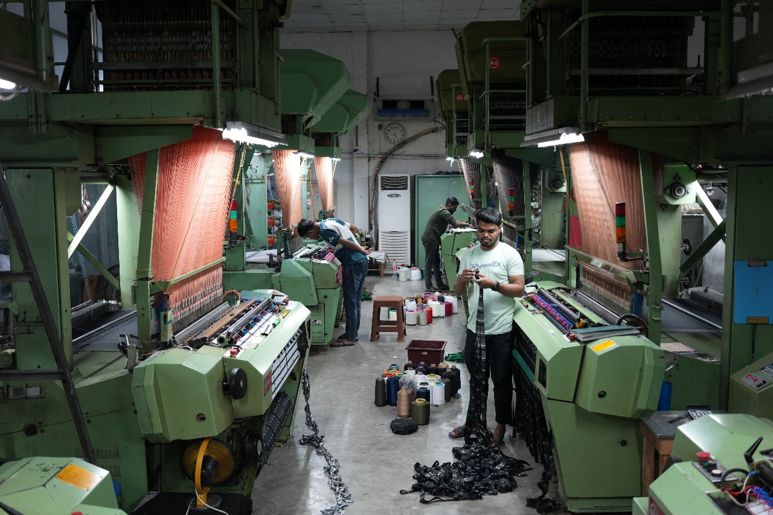
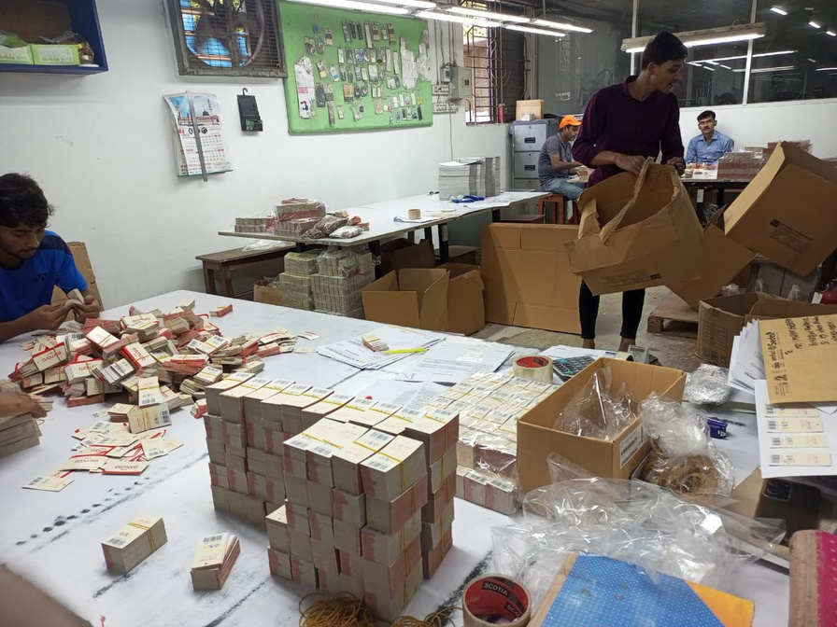
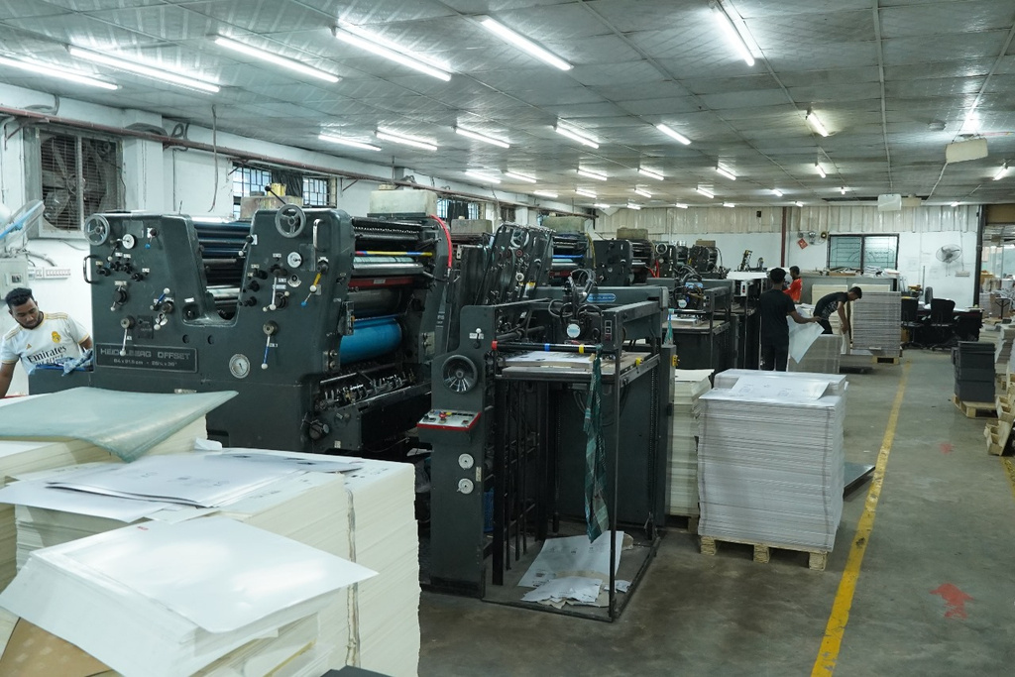
Brandview Sourcing Ltd.
Labels, Tags & Accessories
  Hang tags, barcode tags, price tickets, and brand labels
  Woven labels, printed labels, care labels, and size labels
  Manual finishing, sorting, inspection, and packing support
  Accessories coordination according to buyer specifications
Notes:
10

Slide 12
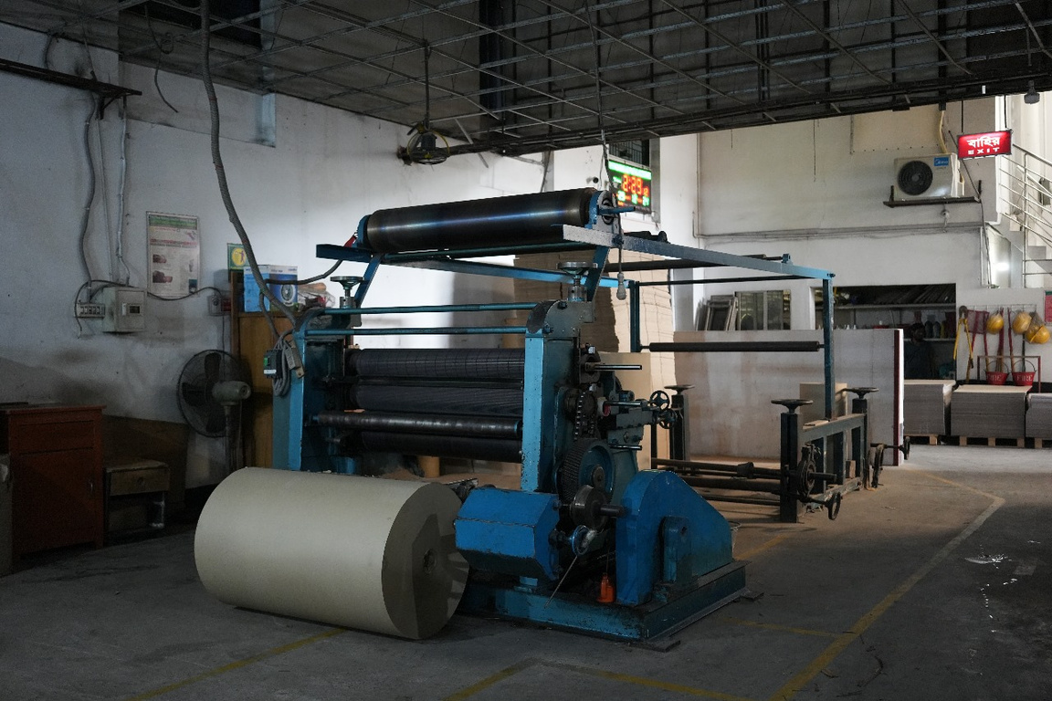
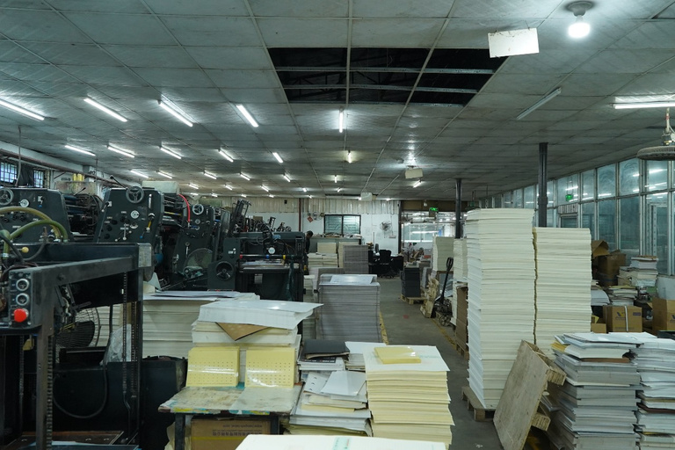
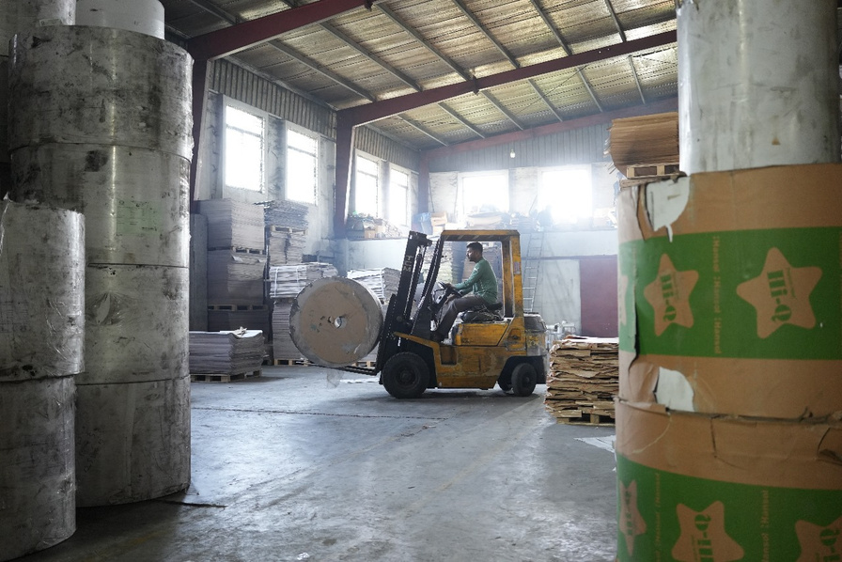
Brandview Sourcing Ltd.
Warehouse & Material Handling
  Raw material storage and inventory handling support
  Organized material movement for printing and packaging production
  Paperboard, carton, and packaging material coordination
  Controlled handling to support smooth production flow

Slide 13
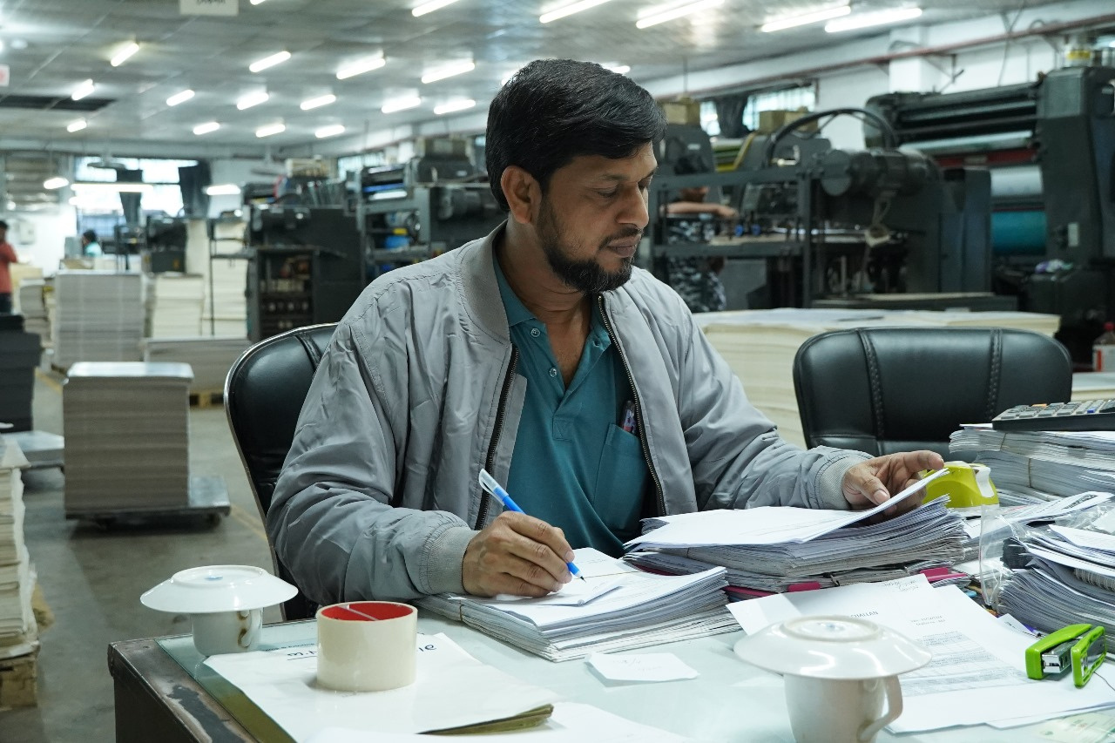
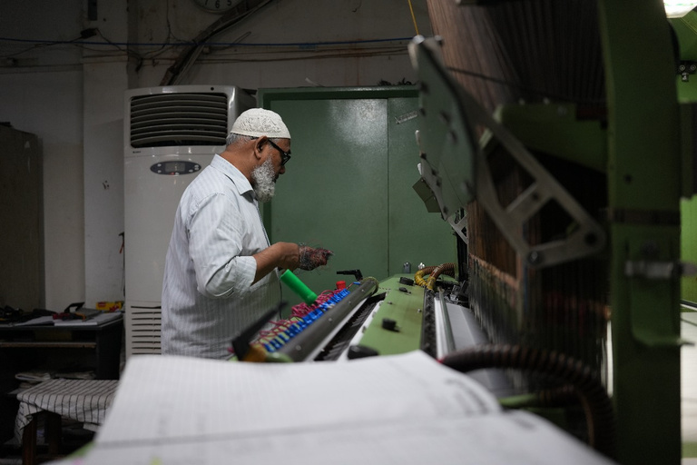
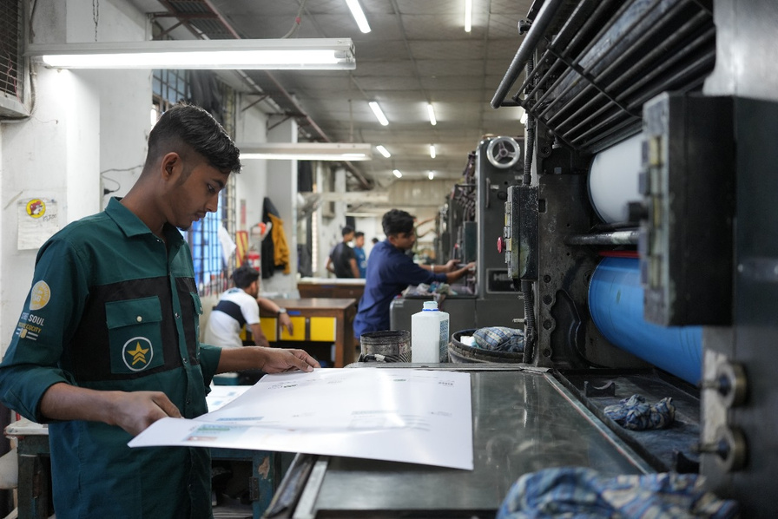
Brandview Sourcing Ltd.
Professional Order Management
  Dedicated coordination for buyer communication and order follow-up
  Production monitoring and documentation control
  Sampling, approval, and shipment schedule follow-up
  Transparent reporting throughout the order execution process

Slide 14
Brandview Sourcing Ltd.
Our Strength Analysis
Extensive Supplier Network
Market Trend Analysis
Broad connections with global suppliers ensure top-quality products at competitive prices.
We scrutinize market trends of fabric, color and style by attending different fair and consult with trend analysis companies.
Comprehensive Logistics Support
Full-service logistics from transportation to distribution for smooth delivery.
Price Competitiveness
We Analyze the product and production efficiency to ensure competitive pricing.
Employee Engagement
Skilled professionals with deep industry knowledge to meet your specific needs.
Notes:
11

Slide 15



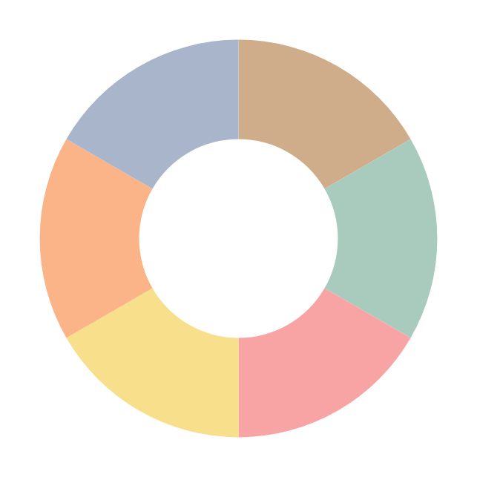




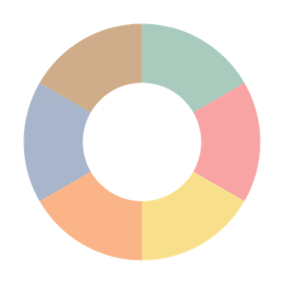






Brandview Sourcing Ltd.
Our Product & Service Portfolio
Men’s
Apperals
6
1
Custom and Promotional Apparel
Here’s an overview of the diverse product categories we handle, tailored to meet the needs of different demographic groups.
Seasonal Clothing
5
2
Underwear
and Sleepwear
Kidswear
4
3
Women’s
Apperals
Notes:
12

Slide 16
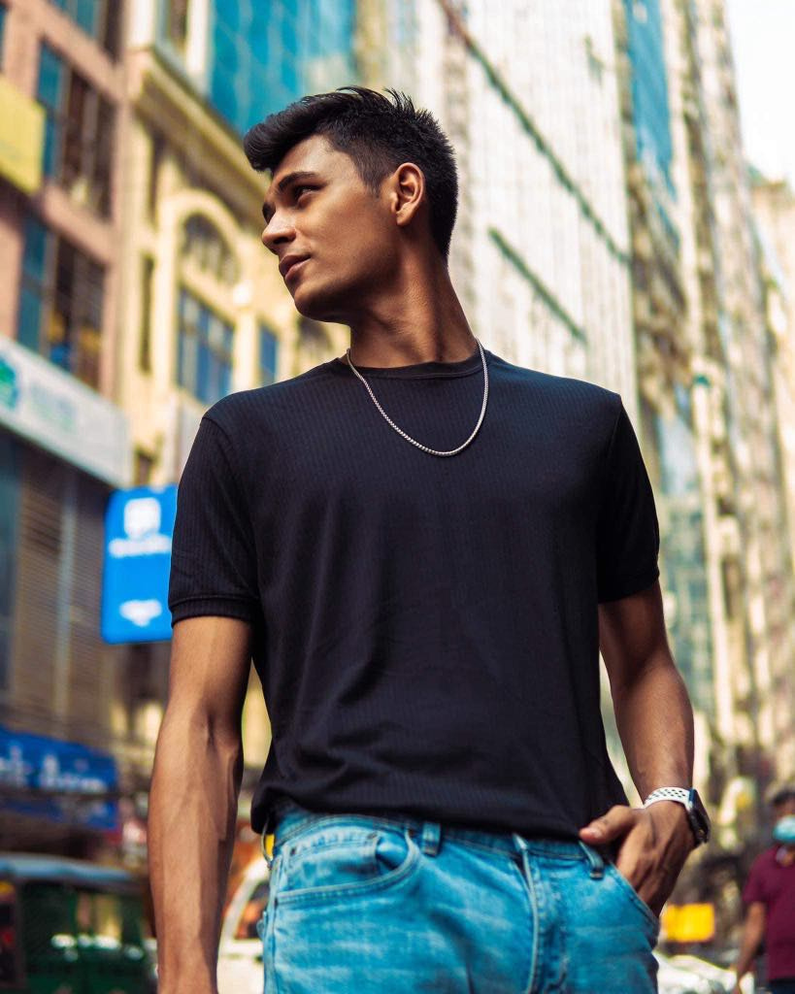
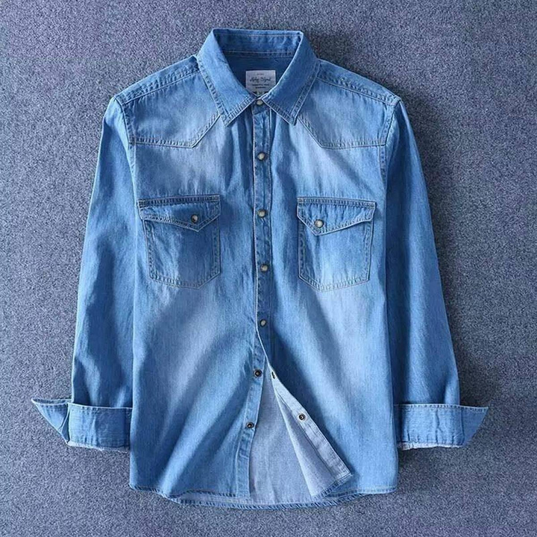
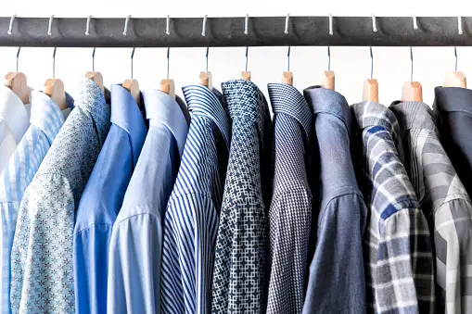
Brandview Sourcing Ltd.
Men’s Collection
Elevate Your Style with Our Men’s Collection
Discover our curated range of men’s apparel designed for every occasion. From timeless classics to contemporary trends, our collection features high-quality fabrics and impeccable craftsmanship.

Slide 17
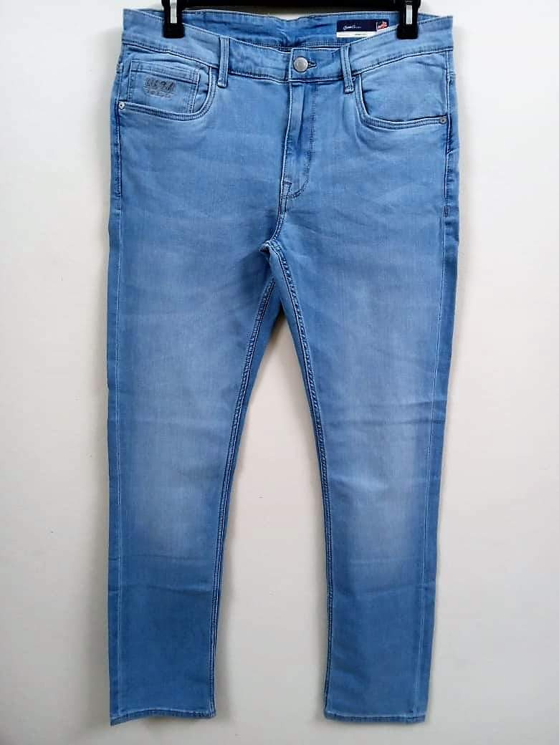
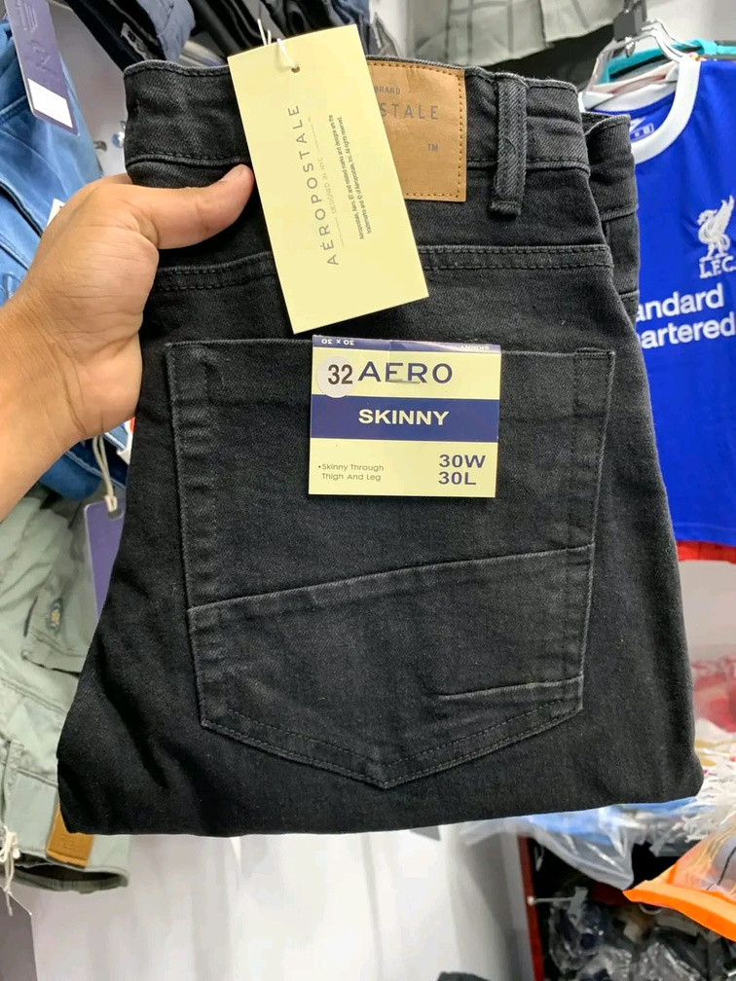
Brandview Sourcing Ltd.
Men’s Collection
Elevate Your Style with Our Men’s Collection
Whether you're dressing up for a business meeting or dressing down for a casual weekend, find the perfect pieces to express your style and confidence.

Slide 18
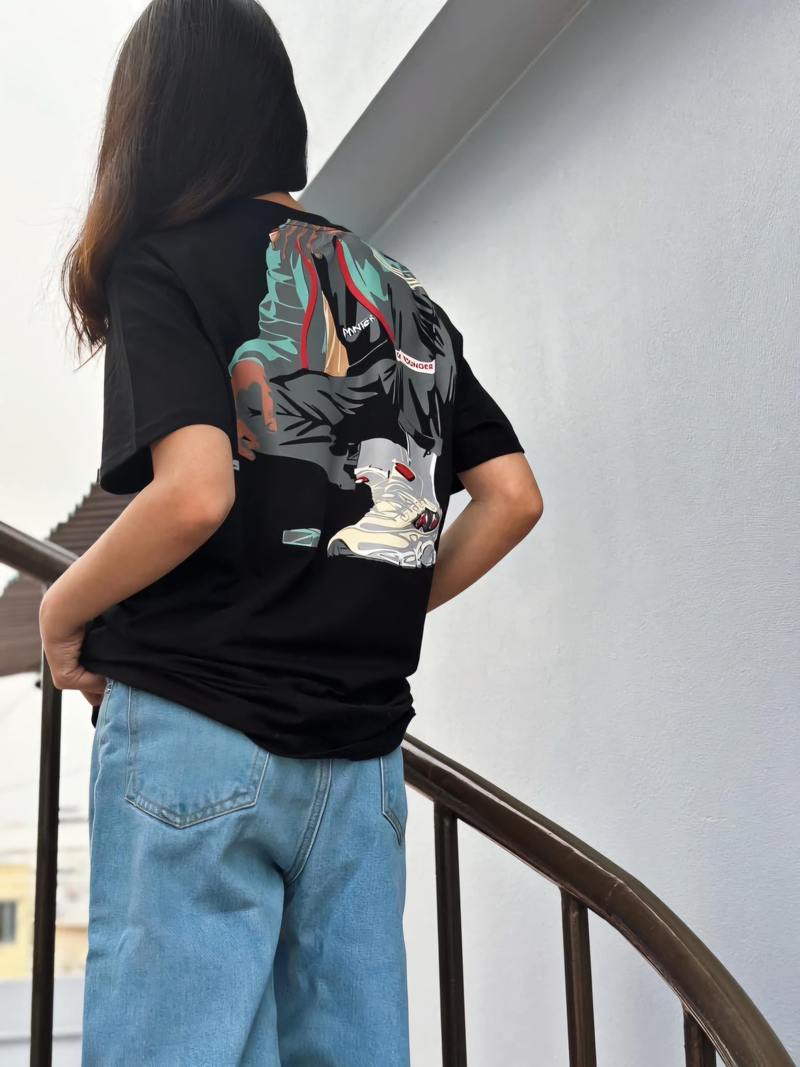
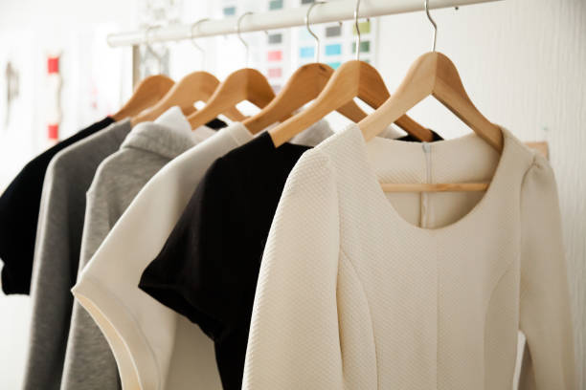
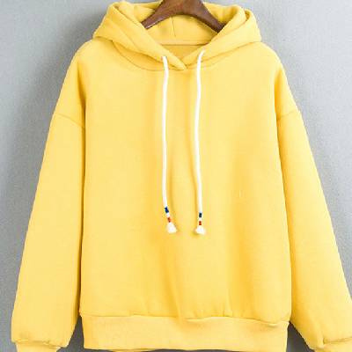
Brandview Sourcing Ltd.
Women’s Collection
Unleash Your Elegance with Our Women’s Collection
Embrace sophistication and grace with our exquisite women’s apparel. Our collection offers a blend of chic designs and versatile styles, crafted to enhance your wardrobe.

Slide 19
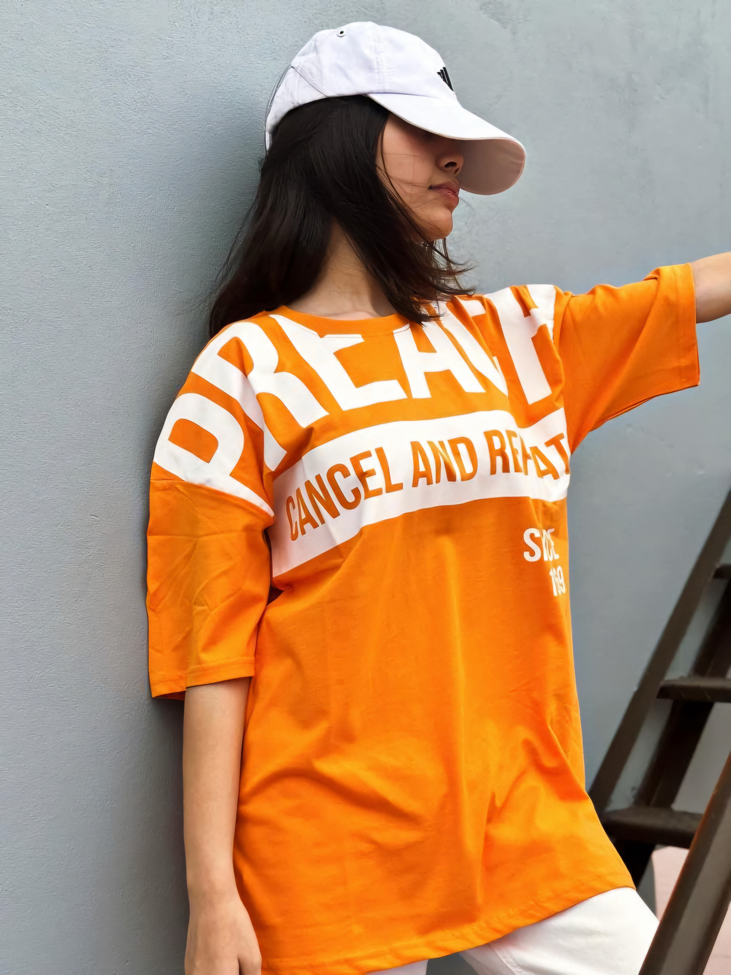
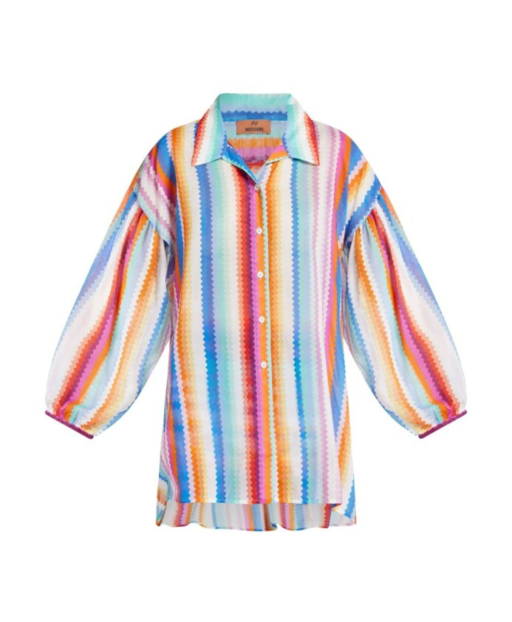
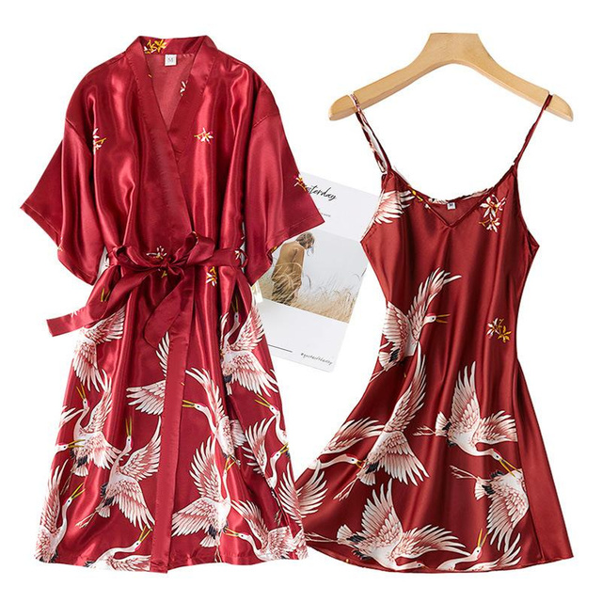
Brandview Sourcing Ltd.
Women’s Collection
Unleash Your Elegance with Our Women’s Collection
From elegant evening wear to comfortable everyday essentials, each piece is thoughtfully designed to make you look and feel fabulous, whatever the occasion.

Slide 20
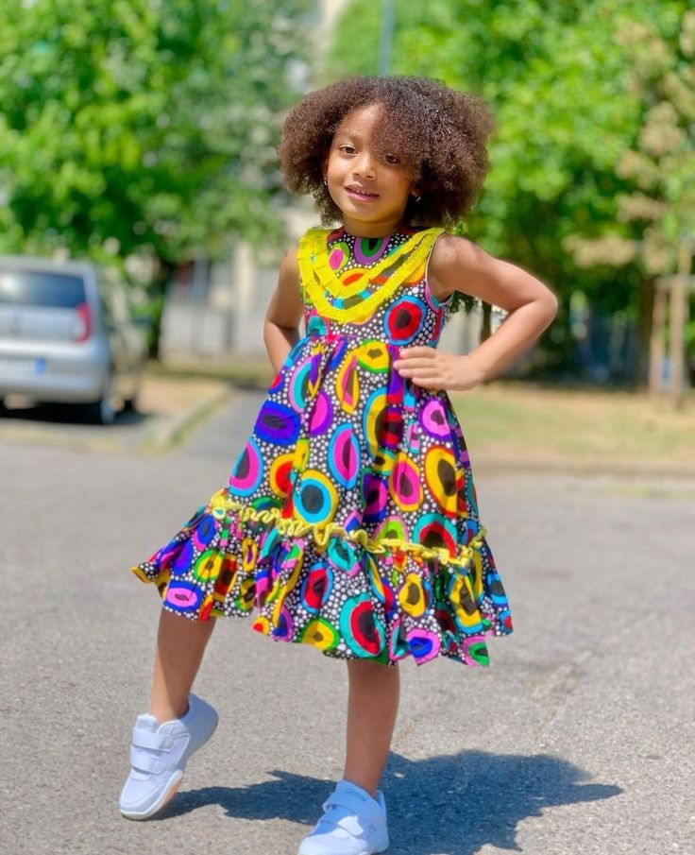
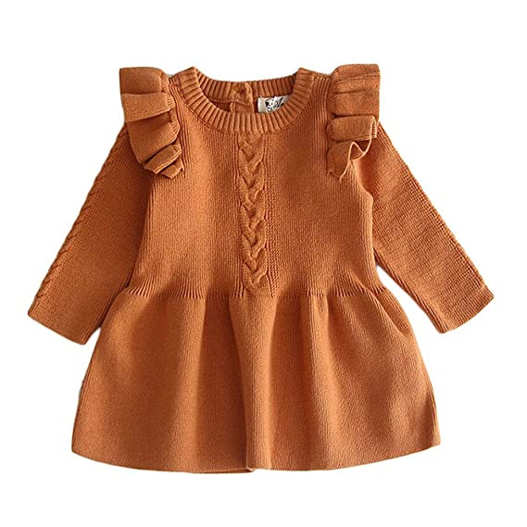
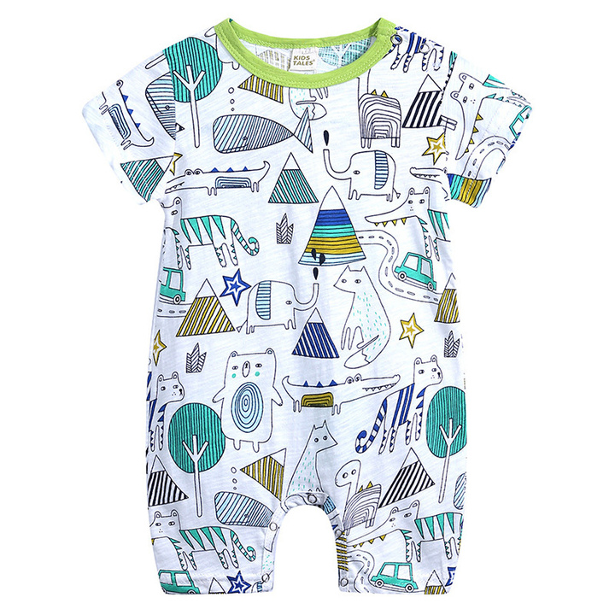
Brandview Sourcing Ltd.
Kids’ Collection
Playful and Practical: Explore Our Kids’ Collection
Delight in our vibrant and durable kids’ apparel designed to keep up with their active lifestyles.

Slide 21
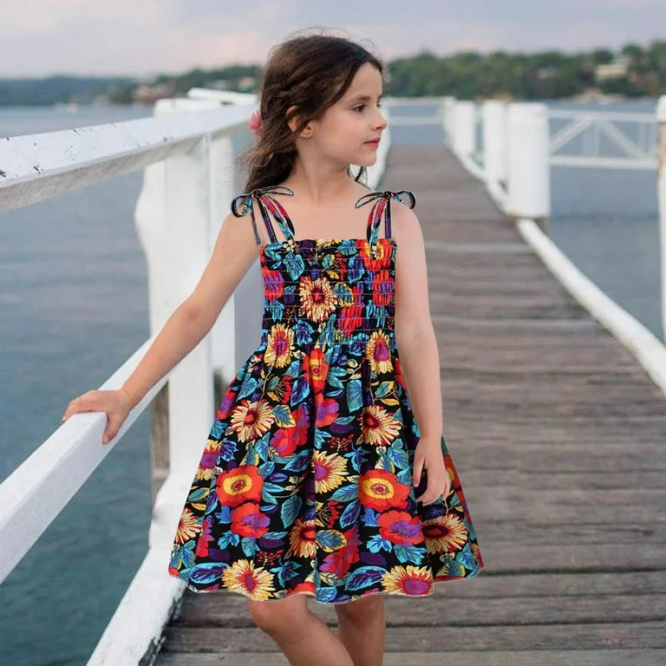
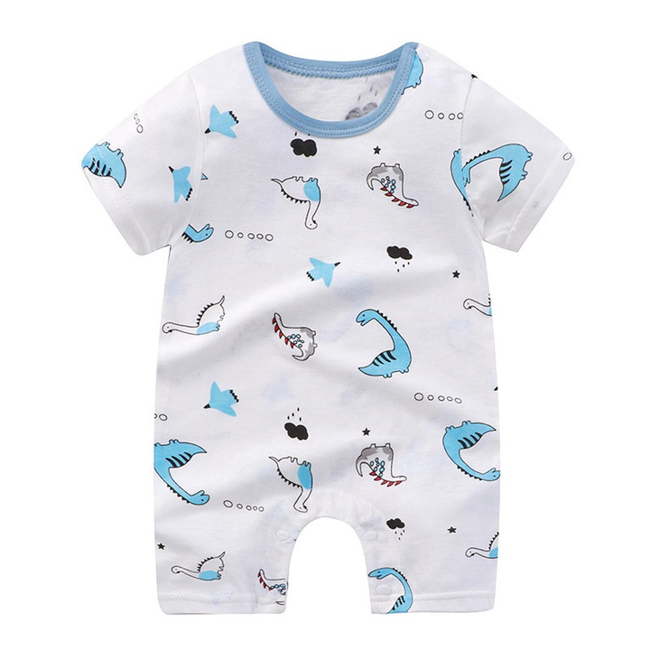
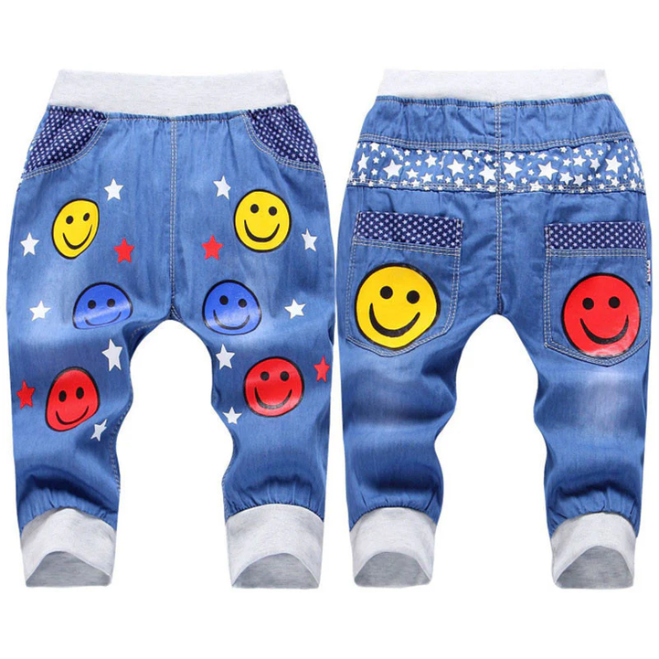
Brandview Sourcing Ltd.
Kids’ Collection
Playful and Practical: Explore Our Kids’ Collection
Our collection combines fun, fashion, and function, ensuring your little ones stay comfortable and stylish all day long. From playful prints to sturdy fabrics, our clothes are perfect for adventures big and small.

Slide 22
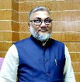
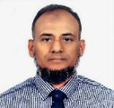
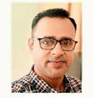
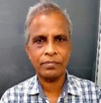
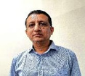
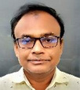
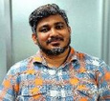
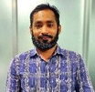
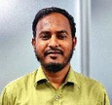
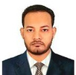



Brandview Sourcing Ltd.
Organogram
S.M ANISUR RAHMAN NANNU
Managing Director
ZAHANGIR ALAM RIPON
Chairman
FEVIN K SASIN
Country Manager
Paritosh Debnath
Head of Merchandising
Sahinur Hossain
Head of Design & Development
Afzal Hossain
Head of Production
Rubel Talukder
Head of Quality Control
Abdur Rouf
CAD Master
Hafiz Gomsta
Accountant
Ariful Islam
IT & Systems Administrator
Rafin Rayhan
Outbound Marketing Executive
Asim Ballave
Admin Manager
M.A.M Murad
Assistant Manager Marketing

Slide 23

Brandview Sourcing Ltd.
Our Team at a Glance
At Brandview Sourcing our success is driven by our dedicated and experienced team. Each member brings unique skills and expertise to ensure we provide the best sourcing and buying solutions for our clients. Here’s a glimpse of the people behind our success.
Our team is committed to excellence and ready to assist you with all your buying needs. Together, we strive to deliver exceptional service and tailored solutions to meet your sourcing requirements.

Slide 24



Our Banking Partner
Brandview Sourcing Ltd.
Name of Company | Brandview Sourcing Ltd.
Year of Establishment | : 2024
Name of Business | 100% Export-Oriented Garments Buying, Apparel Sourcing, Accessories, Printing, Packaging & Export Coordination.
Corporate Office Address | : Plot # 5/7, Road # 29/K, Rupnagar C/A, Mirpur, Dhaka-1216, Bangladesh
B.G.M.E.A Registration Number | :A.M-1282
Email | ripon@brandviewsourcing.com
Contact/Mobile | +880-1819412170
One of the leading banks in Bangladesh, recognized for its strong corporate and offshore banking services.
Mirpur Branch 1 NO DARUSSALAM ROAD MIRPUR-1, DHAKA-1216, BANGLADESH. www.citybankplc.com

Slide 25




Brandview Sourcing Ltd.
Let’s Build Your Next Sourcing Program
Brandview Sourcing Ltd. welcomes inquiries from international brands, retailers, importers, wholesalers, and private-label buyers. Our team is ready to support your sourcing requirements with professional communication, competitive pricing, quality-focused execution, and timely shipment coordination.
Contact Us
Phone Number
+880-1819412170
Thank you for your interest in Brandview Sourcing Ltd.
Email Address
info@brandviewsourcing.com
ripon@brandviewsourcing.com
Website
https://brandviewsourcing.com
Notes:
21

